Slide 1
Pre-Presentation Notes
Slides and presentation materials are available online at:
karlwiegand.com/w4a2014

Slide 2
Intelligent Assistive Communication
and
the Web as a Social Medium
Karl Wiegand
Northeastern University (USA)
April 11, 2014

Slide 3
Outline
Communication and AAC
Common Assumptions
Example Projects
Towards Social AAC

Slide 4
SMCR Model of Communication
Affected by distortion to any component
What if there is distortion from the Source?

Slide 5
Who Uses AAC?
People of all ages
Stephen Hawking and Roger Ebert
Cerebral palsy (CP) -- 53% use AAC(Jinks and Sinteff, 1994)
Amyotrophic lateral sclerosis (ALS) -- 75% use AAC (Ball et al, 2004)
Paralysis, stroke, and more...
Notes:
AAC stands for Augmentative and Alternative Communication

Slide 6
Functional Definitions
Target users are primarily non-speaking and may have upper limb motor impairments
Target users may also have developing literacy or language impairments

Slide 7
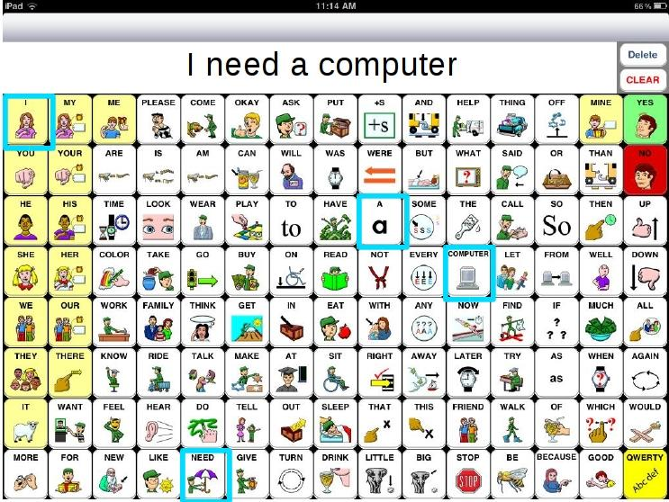
Current AAC Application
Notes:
SpeakForYourself, an icon-based AAC application for iOS and Android

Slide 8
On Speed of Communication
Speech is often 150 - 200 words per minute
(Beasley and Maki, 1976)
vs.
Typical AAC is < 20 words per minute
(Higginbotham et al, 2007)

Slide 9
Passive vs. Active Channels
Current AAC is relatively passive
Intelligent user interfaces (active channels) can reduce distortion and increase speed:
User-Specific
Adaptive
Context-Sensitive

Slide 10
Creating More Intelligent AAC
Many systems, especially AAC, assume:
Prescribed Order
Intended Set
Discrete Entry

Slide 11
Assumption 1: Prescribed Order
Users will select items in a specific order, such as the syntactically "correct" one.
Requires lexical or semantic disambiguation
Users do not always select items in expected order (Van Balkom and Donker-Gimbrere, 1996)
Using AAC devices is slow (Beukelman et al, 1989; Todman, 2000; Higginbotham et al, 2007)

Slide 12
Assumption 2: Intended Set
Users will select exactly the items that are desired -- no fewer or more.
Complete subsets and prune supersets
Motor and cognitive impairments may result in missing or additional selections (Ball, 2004)
Letter-based text entry systems detect accidental and deleted selections

Slide 13
Assumption 3: Discrete Entry
Users will make discrete movements or selections, either physically or with a cursor.
Selection is important; path is irrelevant
Recent letter-based systems have started to remove this assumption (Goldberg, 1997; Kristensson and Zhai, 2004; Kushler and Marsden, 2008; Rashid and Smith, 2008)
Some input methods are naturally continuous

Slide 14
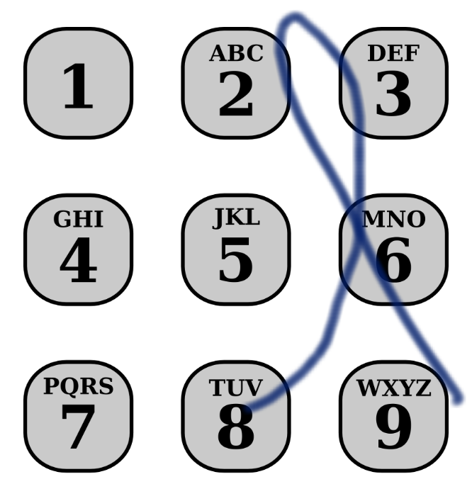
Project: NumCHAT
"Today"

Slide 15
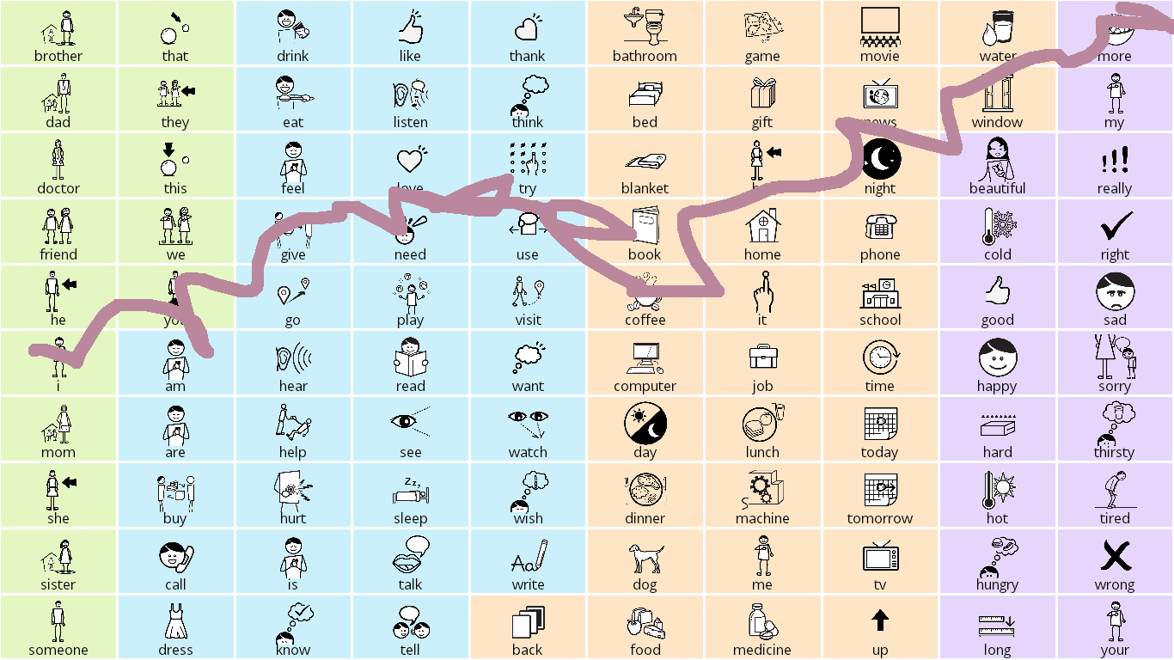
Project: SymbolPath
"I need more coffee."

Slide 16
From Assistive to Social
Most AAC systems are for face-to-face interaction: slow and need-based
What about social interaction?
Many AAC users live at home or in small communities
Turning to the Web to make new friends and keep in touch with family

Slide 17
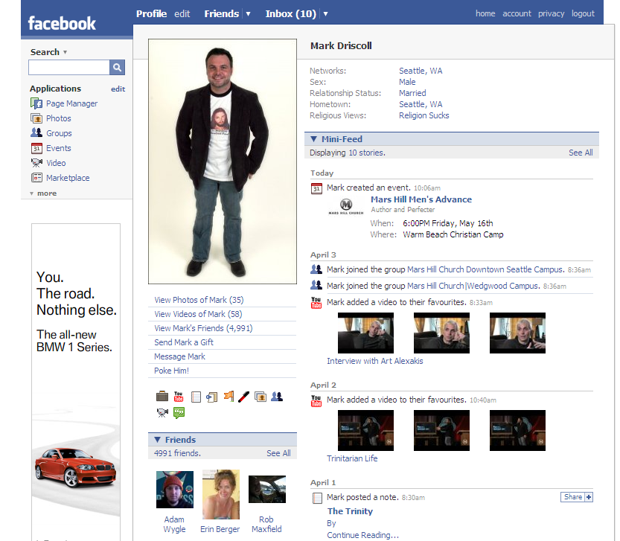

Slide 18
The Web as a Channel
Composition speed is irrelevant (sort of)
Many social barriers go away
Remaining issues:
Navigation complexity or standardization
Information (cognitive) overload
Uniform interfaces or simplification (APIs)

Slide 19
Ontological Engineering
Some say, "Mobile first."
How about, "Semantics first?" (Ha!)
<Post>, <User>, <Profile>?
<Message ReadingLevel=5>?
Problems: <Ad>, <Affiliate_Link> (might as well have "display: none")

Slide 20
On Semantics and Wishful Thinking

Slide 21
TL;DL
The Web is a communication channel.
Assistive technology and Web accessibility standards can reduce noise/distortion and facilitate communication.
Sometimes for those who have difficulty communicating at all.

Slide 22
Thank you for listening! karlwiegand.com/w4a2014
Special thanks to my advisor
(Dr. Rupal Patel), Google, and the National Science Foundation
(Grant #0914808).

