Slide 1
Pre-Presentation Notes
Slides and presentation materials are available online at:
karlwiegand.com/thesis

Slide 2
Disambiguation of
Imprecise User Input
Through Intelligent
Assistive Communication
Karl Wiegand
Northeastern University
Boston, MA USA
June 2013

Slide 3
Thesis Statement
"Intelligent interfaces can mitigate the need for linguistically and motorically precise user input to enhance the ease and efficiency of assistive communication."

Slide 4
Thesis Strategy
"Intelligent interfaces..."
User-specific, adaptive, and context-sensitive
"...can mitigate the need for linguistically and motorically precise user input..."
Demonstrated by algorithms and corpus studies
"...to enhance the ease and efficiency of assistive communication."
Demonstrated by implementations and user studies

Slide 5
Outline
Communication and AAC
Problems to be Addressed
Project and Goals
Theories and Approaches
Implementation and Experiments

Slide 6
Outline
Communication and AAC
Problems to be Addressed
Project and Goals
Theories and Approaches
Implementation and Experiments

Slide 7
SMCR Model of Communication
Affected by distortion to any component
Intelligent components can mitigate the risks of distortion; trend in HCI
What if there is distortion from the Source?

Slide 8
Who Uses AAC?
Stephen Hawking and Roger Ebert
People of all ages
People with:
cerebral palsy (CP) -- 53% use AAC (Jinks and Sinteff, 1994)
amyotrophic lateral sclerosis (ALS) -- 75% use AAC (Ball et al, 2004)
brain and spinal cord injuries
neurological disorders
paralysis, autism, muscular dystrophy, and more...

Slide 9
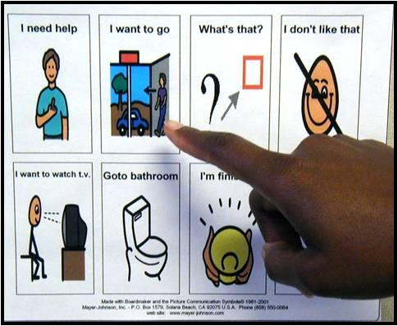
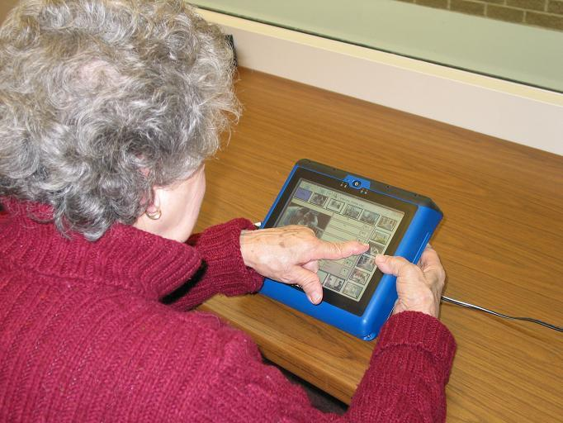
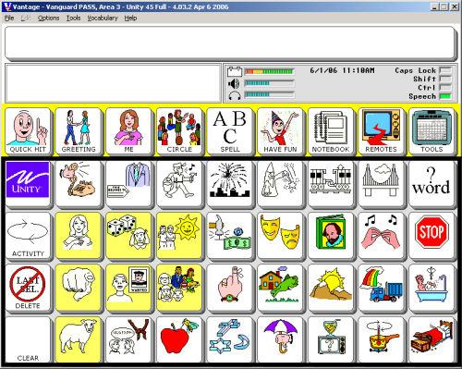
What is AAC?
Physical Boards
Electronic Systems
Letter-Based
Icon-Based

Slide 10
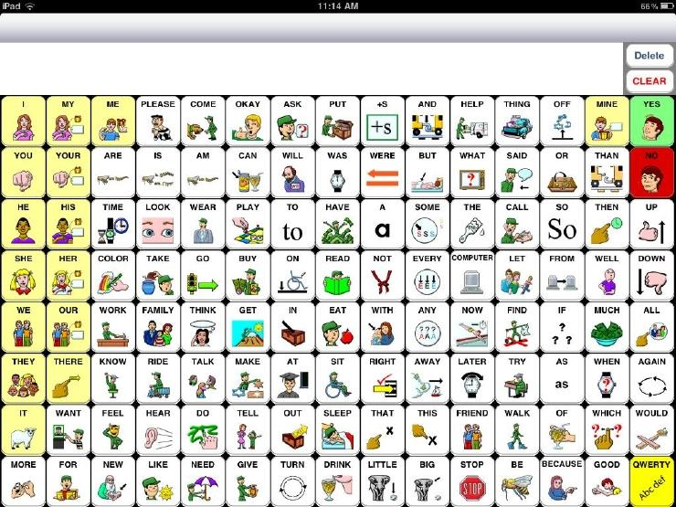
Current AAC Application
Notes:
SpeakForYourself, an icon-based AAC application for iOS and Android

Slide 11
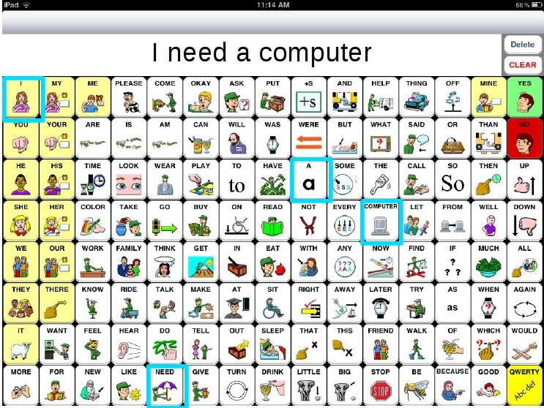
Current AAC Application
Notes:
SpeakForYourself, an icon-based AAC application for iOS and Android

Slide 12
Scope and Definitions
Target users are primarily non-speaking and may have upper limb motor impairments
Target users may also have developing literacy or language impairments
"Icon-based AAC" includes systems that use words, icons, or a combination of both

Slide 13
Outline
Communication and AAC
Problems to be Addressed
Project and Goals
Theories and Approaches
Implementation and Experiments

Slide 14
Problem Statement
Current icon-based AAC systems assume:
Syntactic Order
Intended Set
Discrete Entry

Slide 15
Assumption 1: Syntactic Order
Users will select icons in the syntactically correct order of the target language.
Disambiguate directional utterances
Users do not always select icons in syntactic order (Van Balkom and Donker-Gimbrere, 1996)
Using AAC devices is slow (Beukelman et al, 1989; Todman, 2000; Higginbotham et al, 2007)

Slide 16
Assumption 2: Intended Set
Users will select exactly the icons that are desired -- no fewer or more.
Complete subsets and prune supersets
Motor and cognitive impairments may result in missing or additional selections (Ball, 2004)
Letter-based text entry systems detect accidental and deleted selections

Slide 17
Assumption 3: Discrete Entry
Users will make discrete movements or selections, either physically or with a cursor.
Selection is important; path is irrelevant
Recent letter-based systems have started to remove this assumption (Goldberg, 1997; Kristensson and Zhai, 2004; Kushler and Marsden, 2008; Rashid and Smith, 2008)
Some input methods are naturally continuous (e.g. brain waves, vocalizations)

Slide 18
Problem Summary

Slide 19
Outline
Communication and AAC
Problems to be Addressed
Project and Goals
Theories and Approaches
Implementation and Experiments

Slide 20
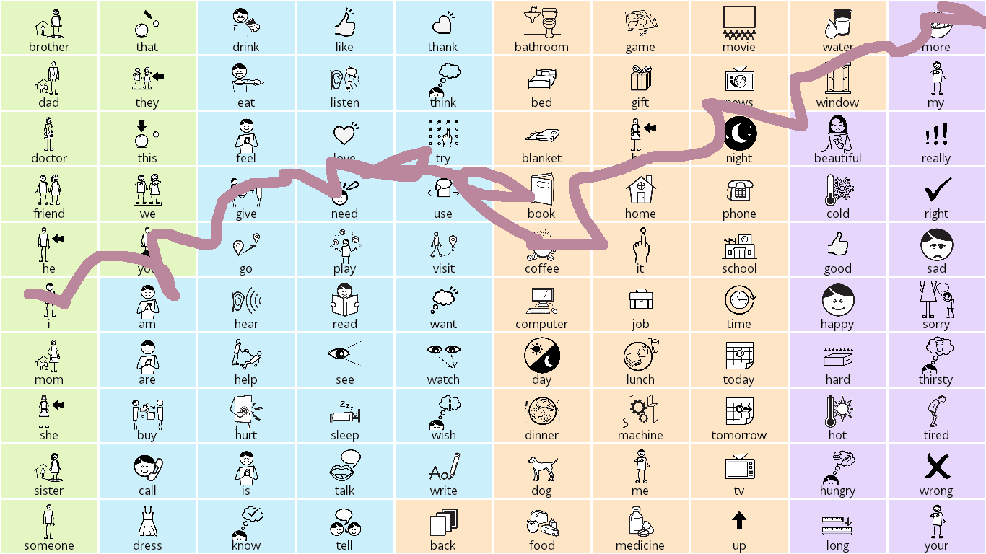
Project: SymbolPath
Relaxation of all three major assumptions
"I need more coffee."

Slide 21
Initial Feedback
Two adults and one child with speech and motor impairments: "It's fun!"
Suggested sentences can be amusing (i.e. "wrong") and longer than normal
It doesn't actually require touch input:
Broad/flat stylus, joysticks, paddles, etc.
It doesn't work well for people with spasms

Slide 22
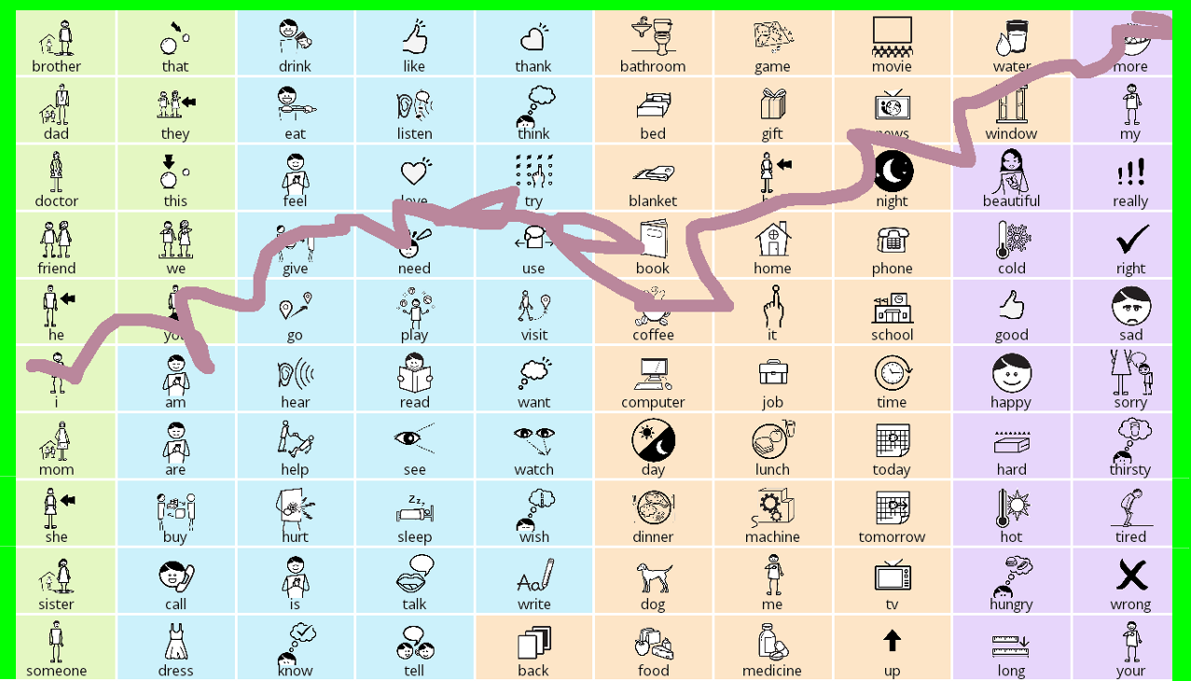
Future Addition: "Finish Line"

Slide 23
Project Goals
Functional test-bed for:
Free order message construction
Completion and correction
Continuous motion
Faster, less fatiguing communication
New input modalities

Slide 24
Outline
Communication and AAC
Problems to be Addressed
Project and Goals
Theories and Approaches
Implementation and Experiments

Slide 25
Addressing Syntactic Order
Statistical MT (Soricut and Marcu, 2006)
Semantic frames, CxG, and PAS (Fillmore, 1976)
Give ( Agent, Object, Beneficiary )
WordNet, FrameNet, "Read the Web"
Verb-first message construction (Patel et al, 2004)
> Free order in SymbolPath (Wiegand and Patel, 2012)

Slide 26
Addressing Intended Set
Subset completion and superset pruning
N-grams; Compansion (McCoy et al, 1998)
> Semantic grams (Wiegand and Patel, 2012)
"I like to play chess with my brother."
Bigrams brother, chess brother, i brother, like brother, play chess, i ... | Trigrams brother, chess, i brother, chess, like brother, chess, play brother, i, like brother, i, play ...

Slide 27
Set-Completion Example
Original Sentence:
“Hey, they’re in first, by a game and a half over the Yankees.”
Target Stem: game
Input Stems: yanke, hey, first, half
N1 Candidate List: game, stadium, like, hour, time, year, day, guy, hey, fan, say, one, two, ...
S1 Candidate List: game, got, like, red, time, play, team, sox, hour, go, fan, one, get, day, ...

Slide 28
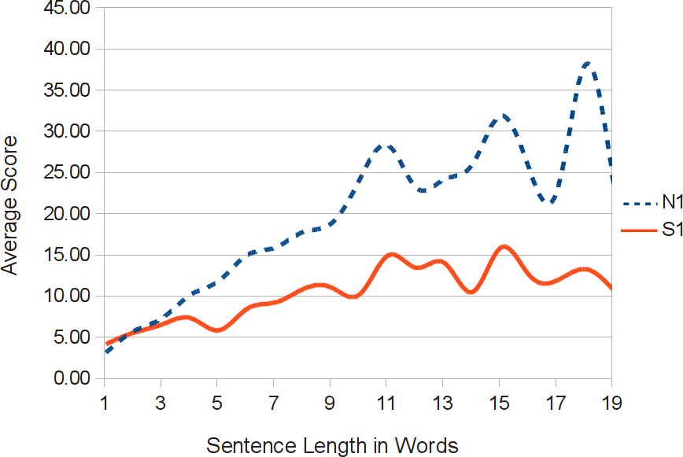
Initial Sem-Gram Results

Slide 29
Addressing Discrete Entry
Physical path or signal characteristics
Rotated unistroke recognition (Goldberg, 1997)
Letter-based paths (Kristensson and Zhai, 2004; Kushler, 2008)
Relative positioning (Rashid, 2008)
Merge semantic salience with path attributes
> Continuous motion in SymbolPath:
Starting and ending locations
Movement speed
Pauses, stops, and sudden directional changes

Slide 30
Outline
Communication and AAC
Problems to be Addressed
Project and Goals
Theories and Approaches
Implementation and Experiments

Slide 31
Proposed Work
Corpus Studies
"...can mitigate the need for linguistically and motorically precise user input..."
Theory
Addressability
User Studies
"...to enhance the ease and efficiency of assistive communication."
Practice
Usability and applicability
> Implementation <

Slide 32
Corpus Studies: Overview
Venues: ACL, ASSETS, EMNLP, SLPAT
Corpora:
Blog Authorship Corpus [age, gender, career]
Crowdsourced AAC-Like Corpus [standard]
Human Speechome Corpus [location, time, role]
TalkBank Corpora
Evaluation via ranked suggestions and set similarity/differences

Slide 33
Proposed Corpus Studies
Syntactic reordering:
Task: Reorder a shuffled sentence
FrameNet vs. N-gram-based permutations
Predicting and pruning selections:
Tasks: Suggest words to add/remove
Sem-grams vs. WordNet+FrameNet vs. tuples
Predicting and pruning selections:
Location, time of day, and discourse markers

Slide 34
User Studies: Overview
Venues: ASSETS, CSUN, ISAAC, RESNA
Design:
Within-subjects to address heterogeneity
Current and potential AAC users (12 - 20)
Cognitive, speech, and motor assessments
Evaluation:
Construction speed, length, and error rate
Quantification of workload via NASA-TLX
Quantification of desirability via Likert scales

Slide 35
Proposed User Studies
Select vs. draw:
Reproduce given utterance (icon set)
System 1: Press icons
System 2: Draw a line through all icons
Prompted response:
Describe given picture card
System 1: Press icons
System 2: Full SymbolPath functionality
* Enhanced AAC:
Features: Reordering and prediction/pruning

Slide 36
Proposed Timeline

Slide 37
Thesis (Redux)
"Intelligent interfaces can mitigate the need for linguistically and motorically precise user input to enhance the ease and efficiency of assistive communication."

Slide 38
Thank you for listening!
Special thanks to the National Science Foundation (Grant #0914808).

Slide 39
Why Icons?
Disadvantages:
Not fully generative
Vocabulary requires screen space
Letter-based research is often inapplicable
Advantages:
Supports limited recall
Doesn't require literacy
Often faster (Todman et al, 1994)

Slide 40
On Speed of Communication
Typical AAC is < 20 words per minute
(Higginbotham et al, 2007)
vs.
Speech is often 150 - 200 words per minute
(Beasley and Maki, 1976)

Slide 41
Likert Scales
Questionnaires w/ Likert items (statements)
Suggested scale attributes:
Symmetric
Equidistant options
Odd number of options
Usually use 5 options:
"strongly disagree" . . . "neither" . . . "strongly agree"
Various forms of the same question (5 - 8)

Slide 42
NASA's TLX Survey
Standardized, researched Likert scales
Five, 7-point scales w/ 21 gradations
Measure ("very low" to "very high"):
Mental Demand
Physical Demand
Temporal Demand (how rushed were you?)
Performance (how successful were you?)
Effort
Frustration

