Slide 1
Pre-Presentation Notes
Slides and presentation materials are available online at:
karlwiegand.com/defense

Slide 2
Disambiguation of
Imprecise User Input
Through Intelligent
Assistive Communication
Karl Wiegand
Northeastern University
Boston, MA USA
December 2014

Slide 3
Thesis Statement
"Intelligent interfaces can mitigate the need for linguistically and motorically precise user input to enhance the ease and efficiency of assistive communication."

Slide 4
Theoretical Contributions
"...mitigate the need for linguistically and motorically precise user input..."
An unordered language model that bridges syntax and semantics. [Wiegand and Patel, 2012A]
An empirical comparison of contextual language predictors. [Wiegand and Patel, 2015B (R1)]
A motor movement study with current and potential AAC users. [Wiegand and Patel, 2015A]

Slide 5
Applied Contributions
"...to enhance the ease and efficiency of assistive communication."
A semantic approach to icon-based, switch AAC. [Wiegand and Patel, 2014B]
A continuous motion overlay module for icon-based AAC. [Wiegand and Patel, 2012B]
Mobile, letter-based AAC that supports conversational speeds. [Wiegand and Patel, 2014A]

Slide 6
Outline
Assistive Communication
Theoretical Contributions
Applied Contributions
Summary and Conclusion

Slide 7
Part 1:
Assistive
Communication

Slide 8
On Communication
SMCR and derivatives [Shannon and Weaver, 1949]
Affected by distortion to any component
What if there is distortion from the Source?

Slide 9
Who Uses AAC?
People of all ages; ~2 million in US [NIH, 2000]
Developmental disorders:
Autism, cerebral palsy...
53% of people with CP use AAC [Jinks and Sinteff, 1994]
Neurological and neuromotor disorders:
ALS, MD, MSA, stroke, paralysis...
75% of people with ALS use AAC [Ball, 2004]
Notes:
AAC stands for Augmentative and Alternative Communication and is primarily used by people for whom...

Slide 10
Functional Definitions
Target users are primarily non-speaking and may have upper limb motor impairments
Target users may also have developing literacy or language impairments

Slide 11
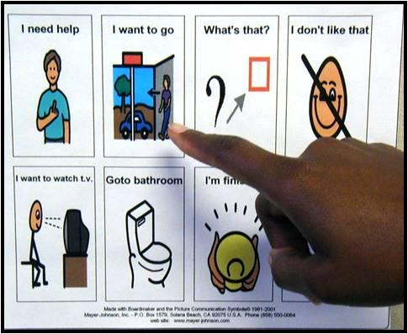
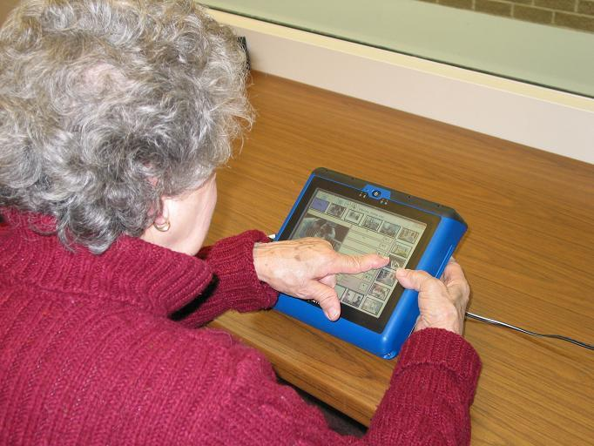
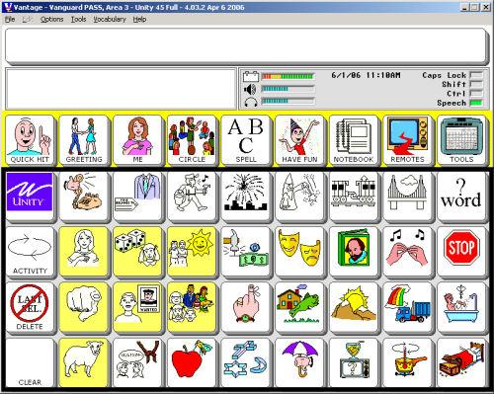
Types of AAC
Physical Boards
Electronic Systems
Letter-Based
Icon-Based

Slide 12
Types of AAC
Physical Boards
Electronic Systems
Letter-Based
Icon-Based

Slide 13
On Speed of Communication
Speech is often 150 - 200 words per minute
[Beasley and Maki, 1976]
vs.
Typical AAC is < 20 words per minute
[Higginbotham et al, 2007]

Slide 14
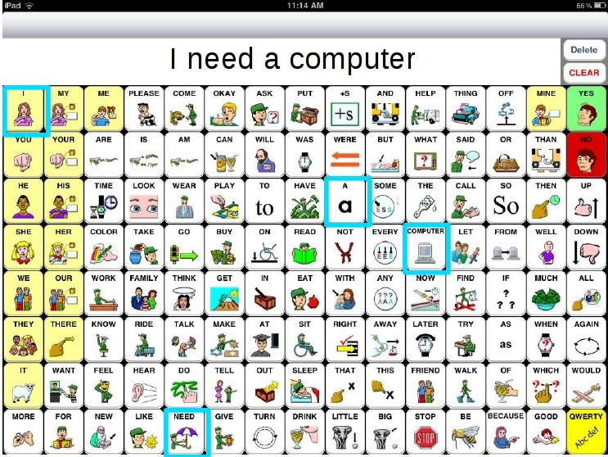
Modern AAC Application
Notes:
SpeakForYourself, an icon-based AAC application for iOS and Android

Slide 15
The Problem

Slide 16
What is the Goal?
Make AAC more intelligent
"Intelligent" meaning:
User-specific
Adaptive
Context-sensitive

Slide 17
How?
By addressing some common assumptions:
Prescribed Order
Intended Set
Discrete Entry

Slide 18
Assumption 1: Prescribed Order
Users will select items in a specific order, such as the syntactically "correct" one.
Users do not always select items in expected order [Van Balkom and Donker-Gimbrere, 1996]
Using AAC devices is slow [Beukelman et al, 1989; Todman, 2000; Higginbotham et al, 2007]
Assumptions of diminished capacity

Slide 19
Assumption 2: Intended Set
Users will select exactly the items that are desired -- no fewer or more.
Motor and cognitive impairments may result in missing or additional selections [Ball, 2004]
Letter-based text entry systems detect accidental and missing selections

Slide 20
Assumption 3: Discrete Entry
Users will make discrete movements or selections, either physically or with a cursor.
Some letter-based systems have started to remove this assumption [Goldberg, 1997; Kristensson and Zhai, 2004; Kushler and Marsden, 2008; Rashid and Smith, 2008]
Many input signals are naturally continuous

Slide 21
The Goal

Slide 22
Part 2:
Theoretical
Contributions

Slide 23
Theoretical Contributions
Prescribed Order
Semantic Frames,
Semantic Grams
Intended Set
Semantic Grams,
Contextual Prediction
Discrete Entry
Personalized Interaction

Slide 24
Theoretical Contributions
Prescribed Order
Semantic Frames,
Semantic Grams
Intended Set
Semantic Grams,
Contextual Prediction
Discrete Entry
Personalized Interaction

Slide 25
Addressing Prescribed Order
Statistical MT [Soricut and Marcu, 2006]
Semantic frames, CxG, and PAS [Fillmore, 1976]
Give ( Agent, Object, Beneficiary )
WordNet, FrameNet, "Read the Web" (NELL), Groningen Meaning Bank
Computationally intense to obtain statistics

Slide 26
Motivating Questions
Can we create a simple and fast language model for use with semantic frames?
Current completion and prediction strategies rely on syntactic order and word distance
N-grams, s-grams, skip-grams, CVSMs, etc.
Compansion [McCoy et al, 1998]
Memory-based LMs [Van Den Bosch and Berck, 2009]
Can utterances be predicted/completed without assuming order and distance?

Slide 27
Motivating Examples
Prior Input: play, video games, i, brother
Output: "My brother and I play video games."
Prior Input: play, chess, i, dad
Output: "I play chess with my dad."
Input: i, brother, ...
Output: ?

Slide 28
Possible Approach
Sentences are one of the smallest units of language that are:
Semantically coherent
Semantically cohesive
Syntactically demarcated
How can they be leveraged for prediction?

Slide 29
Semantic Grams
A multiset of words that appear together in the same sentence.
"I like to play chess with my brother."
brother, chess (1) | brother, i (1)
brother, like (1) | brother, play (1)
chess, i (1) | chess, like (1)
chess, play (1) | i, like (1)
i, play (1) | like, play (1)

Slide 30
More on Sem-Grams
Sentence Boundary Detection (SBD) is fast and relatively accurate (> 98.5%)
Sentences provide dynamic context windows
Sentence-level co-occurrence with uniform weight applied to all relationships in a sentence

Slide 31
Sem-Grams Study
Blog Authorship Corpus
140 million words from 19,320 bloggers
Age range of 13 - 48; balanced genders
Split by authors: 80% training, 20% testing
2 n-gram and 2 sem-gram algorithms
Naive Bayes: N1 and S1
N2 (weighted adjacency) and S2 (full independence)

Slide 32
Method
For every test sentence:
Process (split, stop, stem, and check)
Shuffle stems
Remove one (target)
Query each algorithm for missing stem (ranked list)
Evaluation: random 2000 sentences
Score: position of target (lower score is better)

Slide 33
Results: Example 1
Original: “This semester Im taking six classes.”
Target Stem: class
Input Stems: take, semest, six
N1 Candidate List: next, month, class, hour, last, second, week, year, first, five, flag, ...
S1 Candidate List: class, month, year, last, time, one, go, day, get, school, will, first, ...

Slide 34
Results: Example 2
Original: “Hey, they’re in first, by a game and a half over the Yankees.”
Target Stem: game
Input Stems: yanke, hey, first, half
N1 Candidate List: game, stadium, like, hour, time, year, day, guy, hey, fan, say, one, two, ...
S1 Candidate List: game, got, like, red, time, play, team, sox, hour, go, fan, one, get, day, ...

Slide 35
Results: Example 2
Original: “Hey, they’re in first, by a game and a half over the Yankees.”
Target Stem: game
Input Stems: yanke, hey, first, half
N1 Candidate List: game, stadium, like, hour, time, year, day, guy, hey, fan, say, one, two, ...
S1 Candidate List: game, got, like, red, time, play, team, sox, hour, go, fan, one, get, day, ...
Notes:
To further demonstrate the difference between these two approaches, I've highlighted some of the words here...

Slide 36
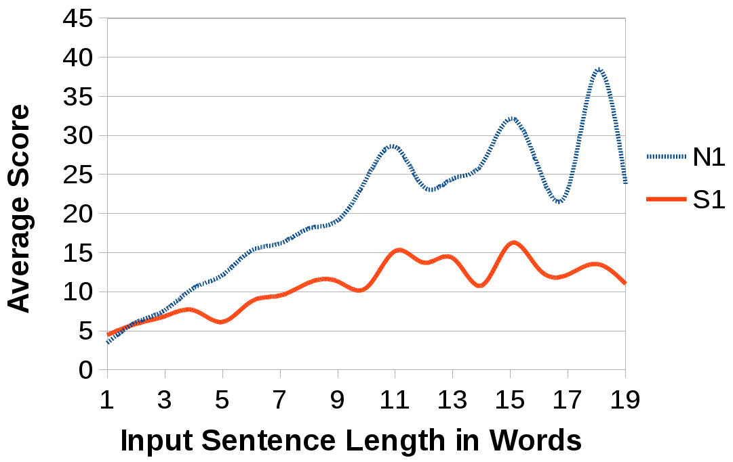
Results: Performance of Sem-Grams

Slide 37
Summary of Sem-Grams
Simple, "fast" (SBD), and distance-agnostic
More accurate than similar n-gram-based algorithms
Alternative to more complex methods
Natural fit for use with semantic frames

Slide 38
Theoretical Contributions
Prescribed Order
Semantic Frames,
Semantic Grams
Intended Set
Semantic Grams,
Contextual Prediction
Discrete Entry
Personalized Interaction

Slide 39
Improving Unordered Prediction
Dropping assumption of order results in information loss
How can we compensate?
Devices often ask for user demographics
Mobile AAC devices have sensors:
Date
Time
Location

Slide 40
Motivating Questions
Almost all statistical LMs require background probabilities (priors)
Most systems use Google's N-Gram Corpus, Wall Street Journal, or New York Times
How much closer to a real user's priors can we get by leveraging context?

Slide 41
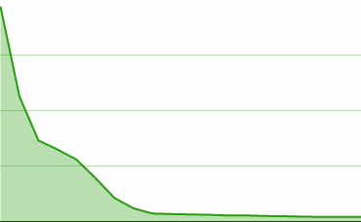
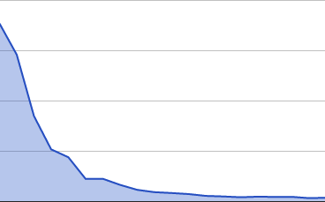
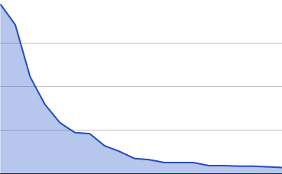
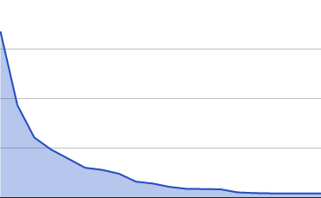
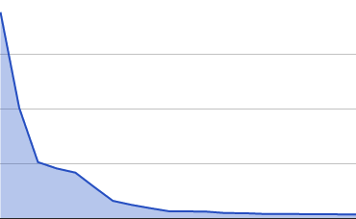
Contextual Prediction
23-year-old female in Seattle
23-year-olds
Global
Seattle
23-year-old females

Slide 42
Contextual Prediction Study
Blog Authorship and Yelp Academic Dataset
Contexts: age, gender, day of the week, day of the month, month, city, and state
Map unigrams to contexts for all authors; minimal stops and no stemming
Attribute | Blog Authorship | Yelp
Authors | 19,320 | 130,850
Features | 525,253 | 134,199

Slide 43
Method
Split by authors: 90% training, 10% testing
For every test author's unique context:
Obtain the true distribution (target)
Compare to distribution from each predictor combo based on non-target 9 folds
Metrics: Kullback-Leibler Divergence, Cosine Similarity, and Precision@20

Slide 44
Method Example
Target Distribution
Age: 23
Gender: Female
DOW: Monday
DOM: 25 - 31
Month: July
City: Seattle
State: Washington
Predictor Combos
Age
Gender
DOW
Age + Gender
Month + City
Age + Gender + City
...
(48 in total)

Slide 45
Results: Predictors by Metric
KL Divergence | Rank | CosSim & Prec@20
DOW+DOM+Month+City | 1 | Gender+DOM+Month
Age+Gender+DOW+DOM+Month | 2 | Gender+Month
Age+DOW+DOM+Month | 3 | Age+Month
DOW+DOM+Month+State | 4 | Gender+DOW+Month
DOW+Month+City | 5 | Age+Gender
Age+Gender+DOW+Month | 6 | Age
DOM+Month+City | 7 | Age+DOM
. . .
(No Context) | 47 | 31, 27 | (No Context)

Slide 46
Summary of Context
Contextual distributions can be more accurate than global statistics
Location better by KL; demographics better by CosSim and Prec@20
Some combinations consistently better:
Gender + DOM + Month
Age + Gender + DOW + Month
Age + Gender + DOM
Age + Month

Slide 47
Theoretical Contributions
Prescribed Order
Semantic Frames,
Semantic Grams
Intended Set
Semantic Grams,
Contextual Prediction
Discrete Entry
Personalized Interaction

Slide 48
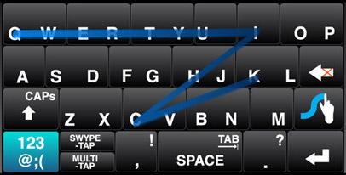
Addressing Discrete Entry
Physical path or signal characteristics
Rotated unistroke recognition [Goldberg, 1997]
Letter-based paths [Kristensson and Zhai, 2004; Kushler, 2008]
Relative positioning [Rashid, 2008]
Well-received by non-disabled users

Slide 49
Motivating Questions
Modern AAC now deployed on touchscreens
Increasing research on accessibility
Fitts and Steering Laws [Fitts, 1954; Accot and Zhai, 1996]
Swabbing/sliding is easier [Wacharamanotham et al, 2011]
Buttons need to be bigger [Chen et al, 2013]
What about functional compensation?
Can we learn realistic, layout-agnostic interaction patterns for an individual user?

Slide 50
Motor Optimization GUI (MoGUI)

Slide 51
MoGUI Example

Slide 52
MoGUI Study
Residents at the Boston Home
Current and potential AAC users
10 females and 5 males
Ages 35 - 71 (mean of 56)
8 right-handed; 7 left-handed (3 due to MS)
2 cross-balanced sessions: taps vs. slides
4x4 grid = 16 locations
Pseudo-random shuffling (a la Latin Squares)

Slide 53
Method
10.1" Android tablet in comfortable, landscape position; fully reachable
Choice of finger or stylus
10 levels of 3 rounds each
1, 2, 3, ...10 balloons per round = 165 total
Track all hits, misses, and timing

Slide 54
Results: Variability of Tap Misses
Multiple Taps
Fingers Dragging
Hand Resting
Thumb Usage

Slide 55
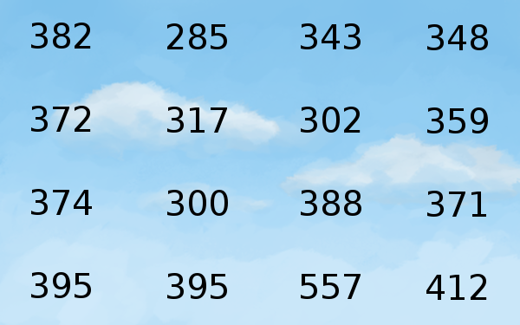
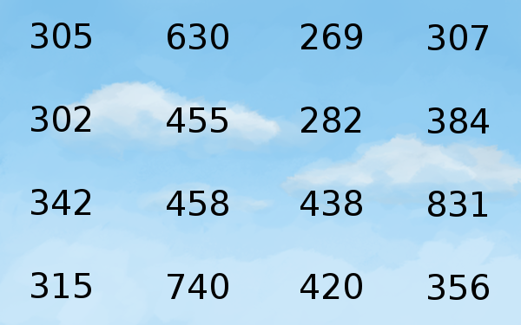
Results: Locations by Handedness
Left
Right
Mean speed-to-target in pixels/second

Slide 56
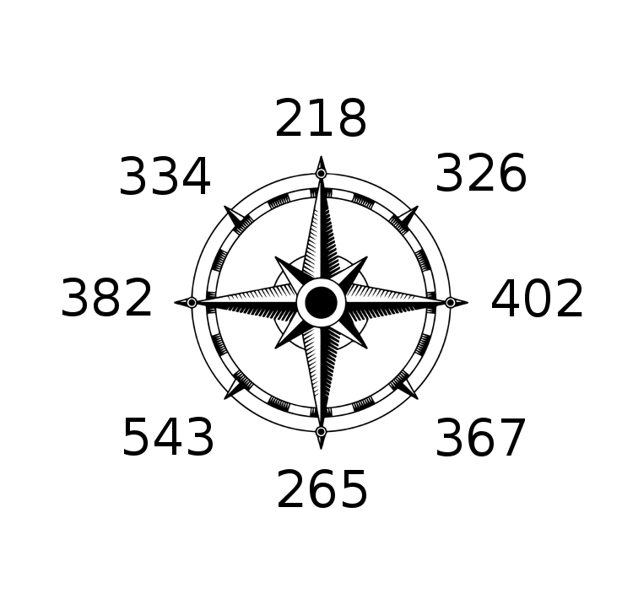
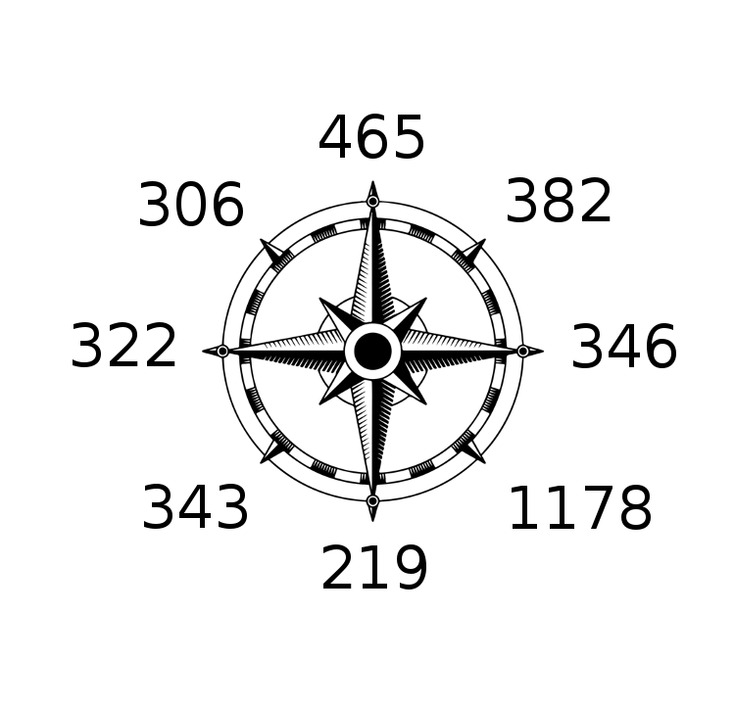
Results: Directions by Handedness
Left
Right
Mean speed-to-target in pixels/second

Slide 57
Summary of Personalization
Sliding not significantly faster than tapping for arbitrary targets; no motor learning
16% accidental slides; 43% accidental taps
High variance in individual motor patterns; weak correlations by handedness
Gamified calibration
Static improvements through personas:
Handedness → margins, button locations
Tap/slide preferences → input sensitivity

Slide 58
Part 3:
Applied
Contributions

Slide 59
Applied Contributions
RSVP-iconCHAT
Free Order,
Discrete Icons
SymbolPath
Free Order,
Continuous Icons
DigitCHAT
Mobile, Mixed-Input Letters

Slide 60
A Collaborative Effort
Locked-In Syndrome (LIS)
Spinal injuries, ALS, tumors, strokes...
1% of ischemic strokes [Smith and Delargy, 2005]
Icon-based, switch AAC for people with LIS
Dr. Deniz Erdogmus and Dr. Rupal Patel
Minimal switch/signal requirements (1+)
Goal of a brain-computer interface (BCI)
Verb-first message construction [Patel et al, 2004]

Slide 61
Rapid Serial Visual Presentation
Used in psychology, speed-reading, lie detection, and letter-based BCI [Orhan et al, 2012]

Slide 62
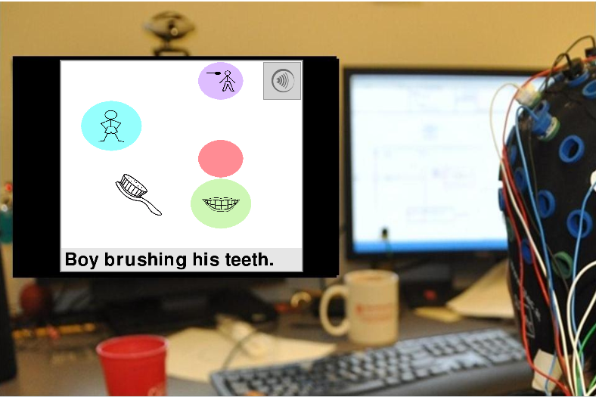
RSVP-iconCHAT

Slide 65
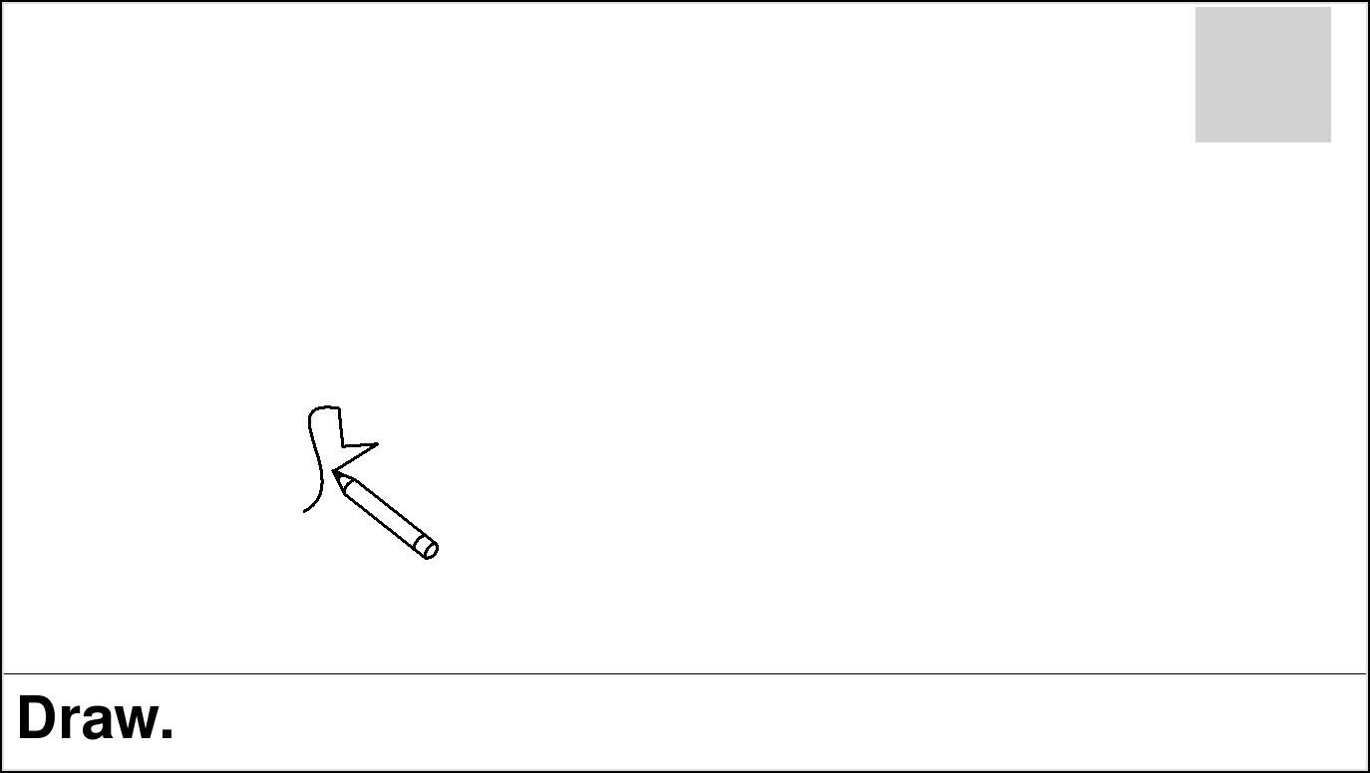

Slide 66
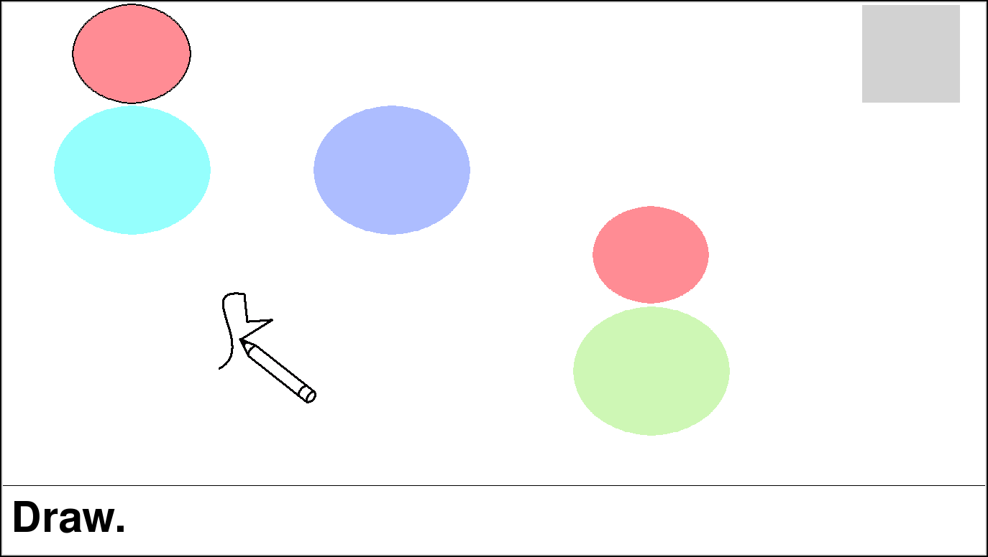

Slide 67
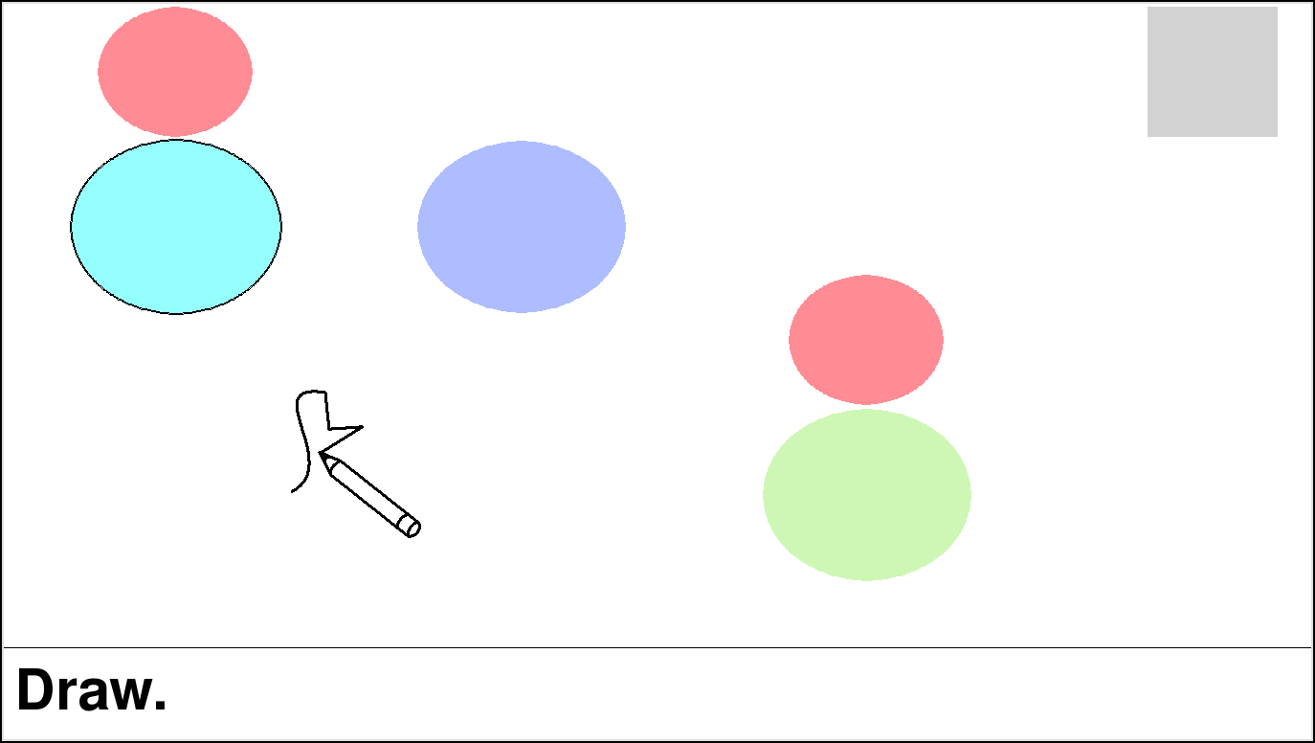

Slide 69
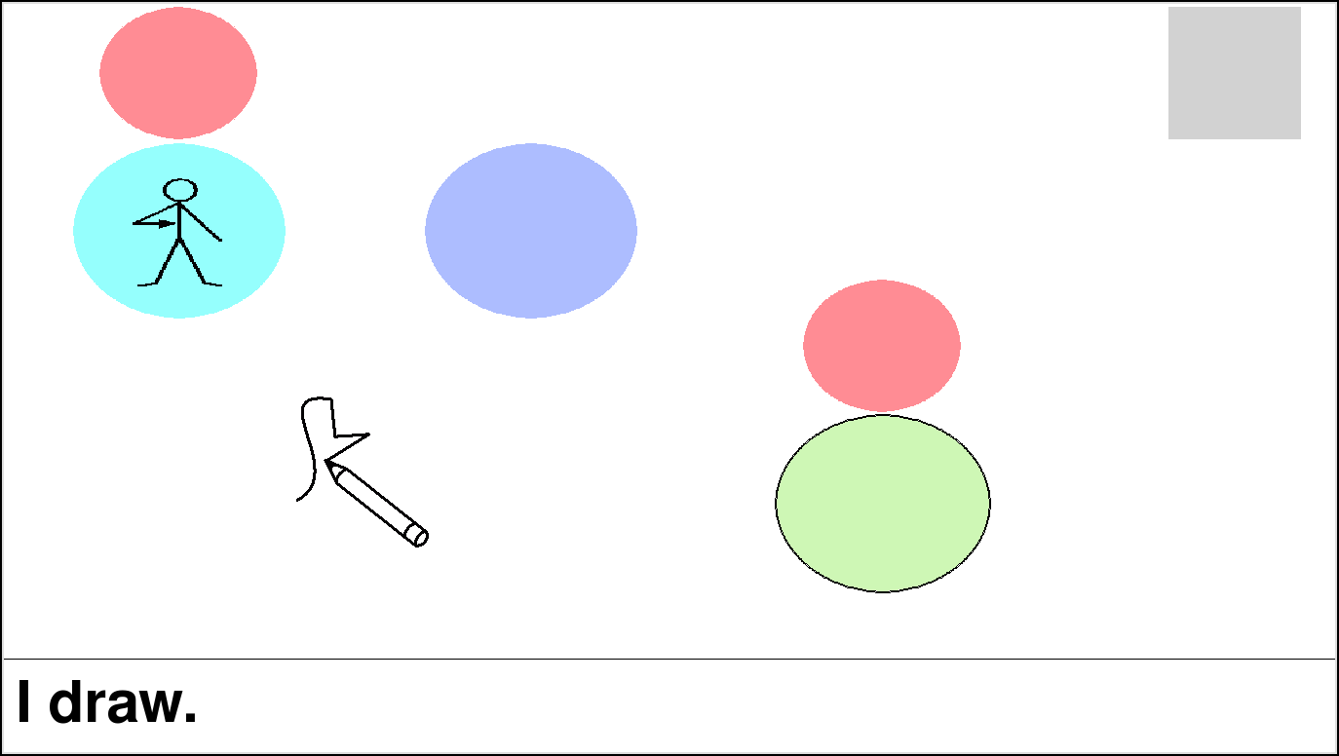

Slide 70
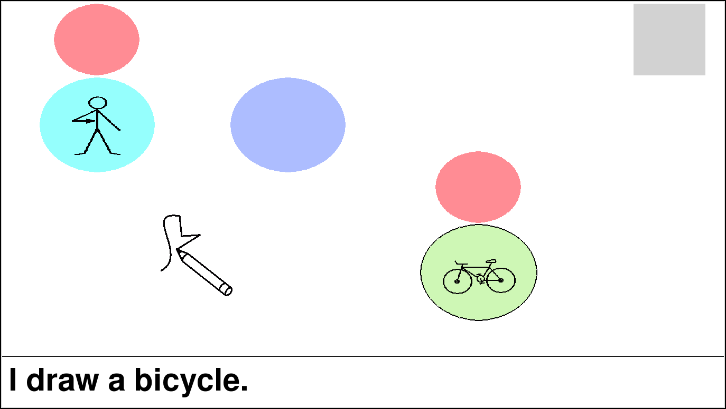

Slide 72
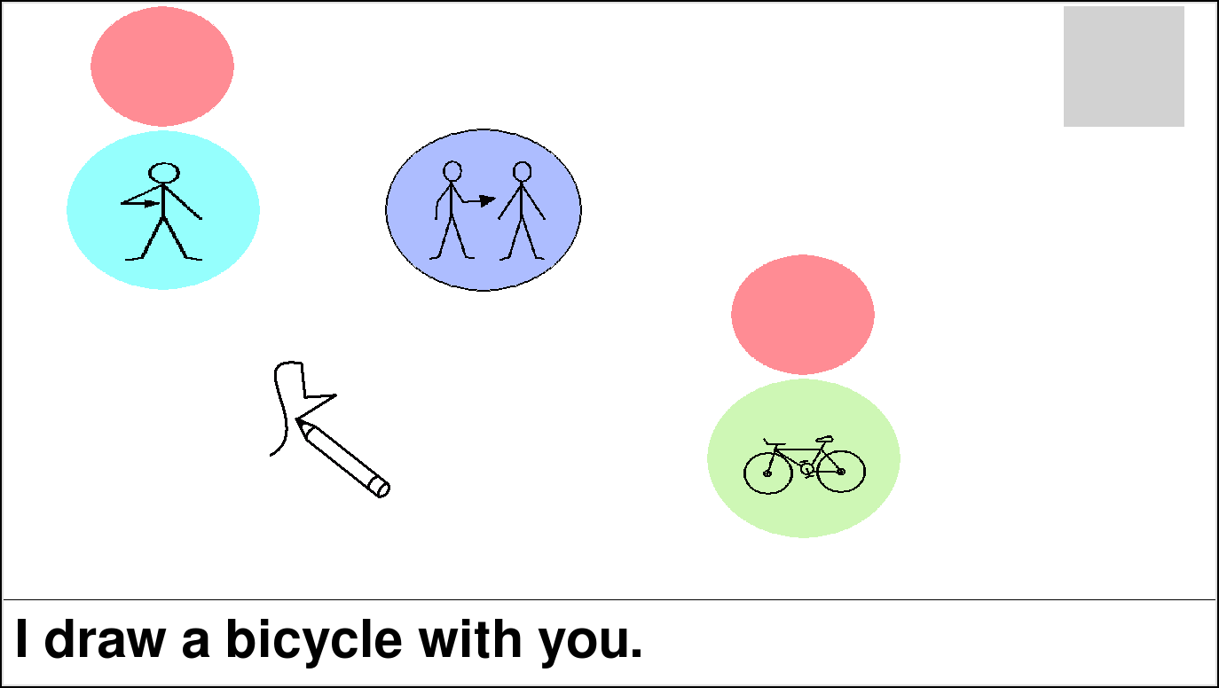
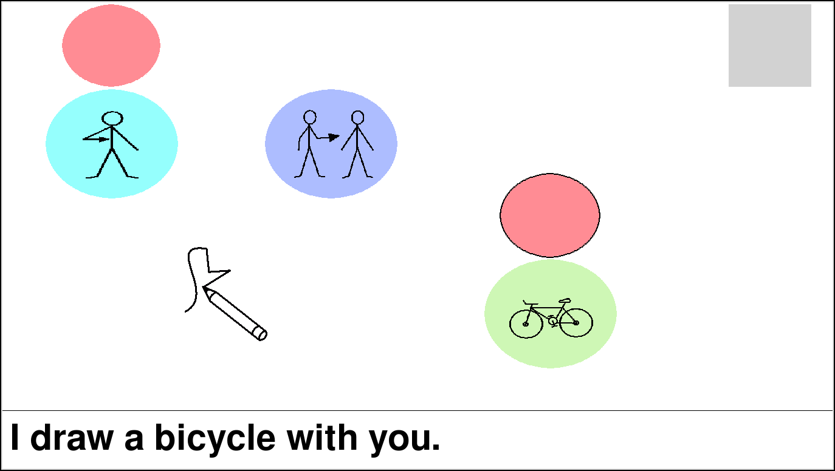

Slide 73
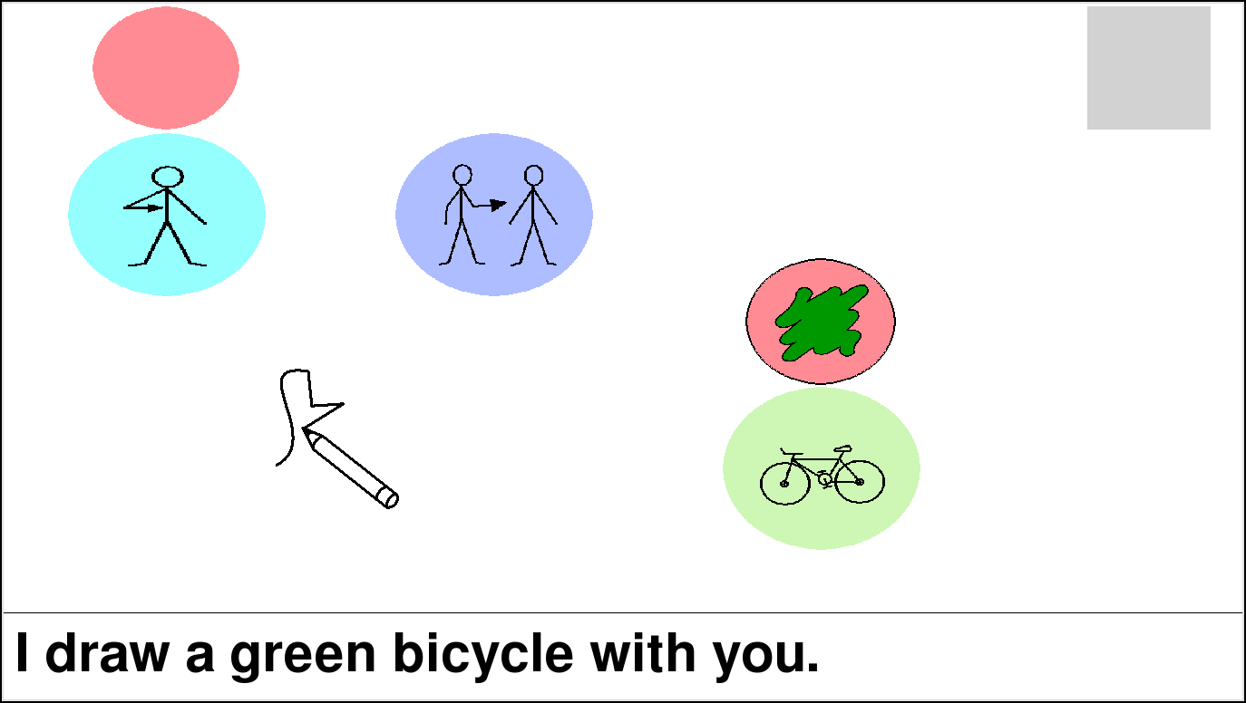

Slide 74
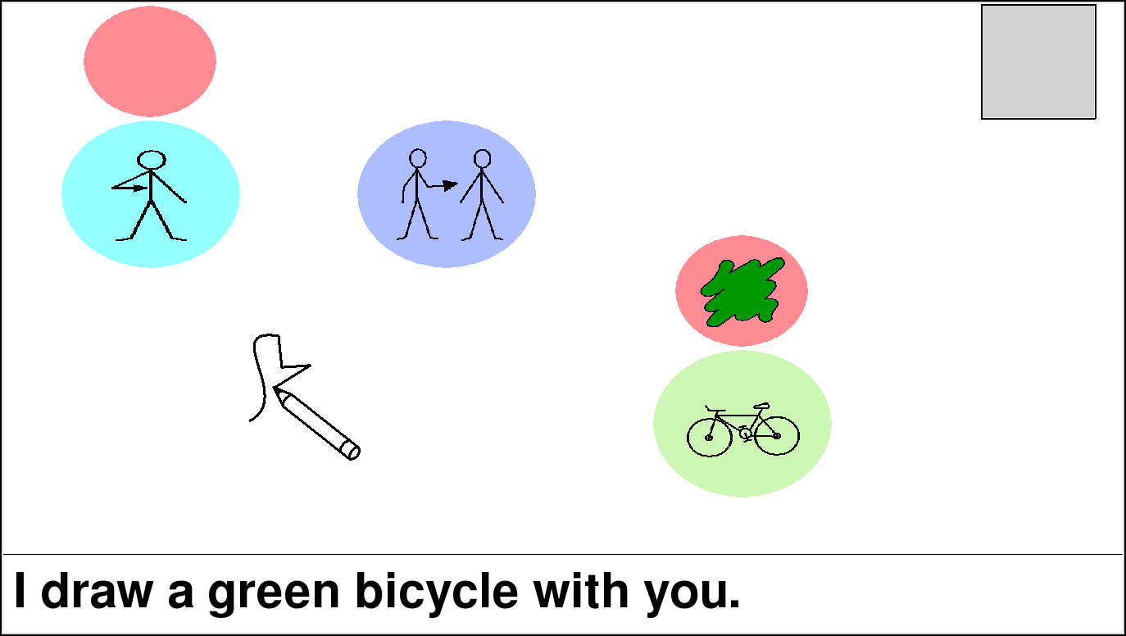

Slide 75
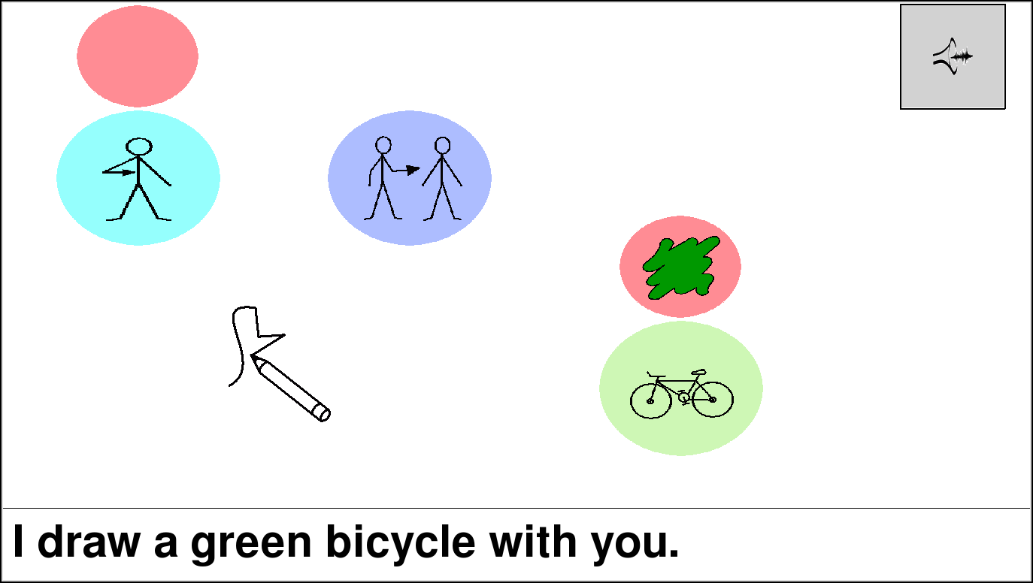

Slide 76
Observations
Prediction/ordering controls speed of message construction
Natural fit for prediction via semantic grams
Required screen space is now tied to message complexity

Slide 77
RSVP-iconCHAT Study
24 non-disabled participants (ND)
14 females and 10 males
Ages 19 - 43 (mean of 24)
4 participants with speech and motor impairments (SMI)
2 females and 2 males
Ages 33 - 56 (mean of 41)
Space bar as switch mechanism
Up to 106 words in alphabetic order

Slide 78
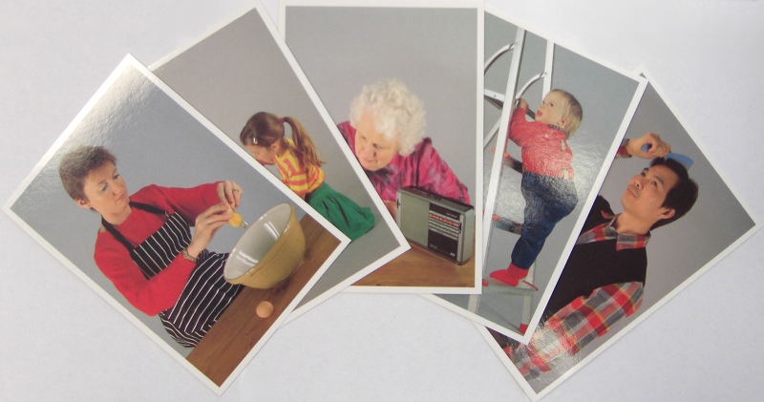
Method
For every participant:
Introduction and 3 training cards
Shuffle 30 picture cards
Use the system to describe each card
RSVP starting at 700ms; adjustable at any time

Slide 79
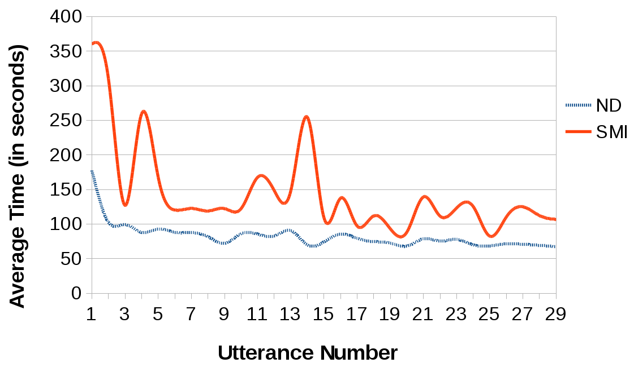
Results: Construction Time

Slide 80
Overview of Results
Average speed of last 5 utterances:
70s (ND) vs. 107s (SMI)
No nonsensical utterances
Average of 5 selections (verb + 4)
RSVP speeds w/ positive motor response:
700ms (ND) vs. 1200ms (SMI)

Slide 81
Summary of RSVP-iconCHAT
Immediately applicable to mobile systems
Message complexity can be scaled (personalized)
Exandable to multi-modal or analog input:
Push the switch harder to go faster
Directional switches
"Oops" functionality
Involuntary responses (BCI) could leverage predictive reordering via sem-grams

Slide 82
Applied Contributions
RSVP-iconCHAT
Free Order,
Discrete Icons
SymbolPath
Free Order,
Continuous Icons
DigitCHAT
Mobile, Mixed-Input Letters

Slide 83
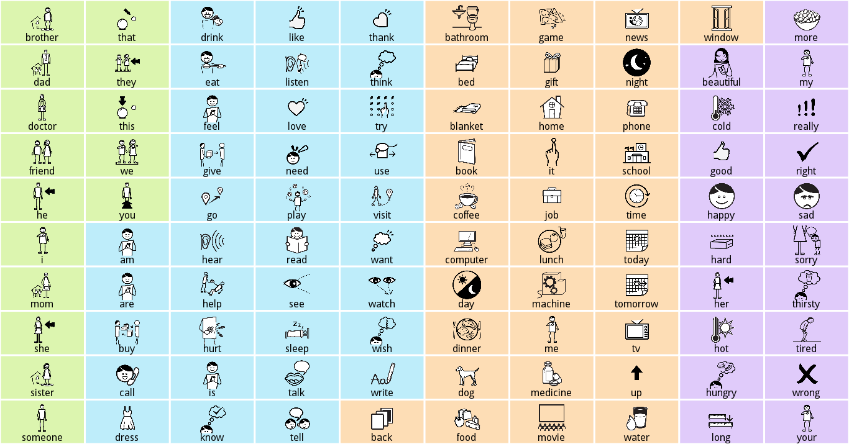
SymbolPath Motivation

Slide 84
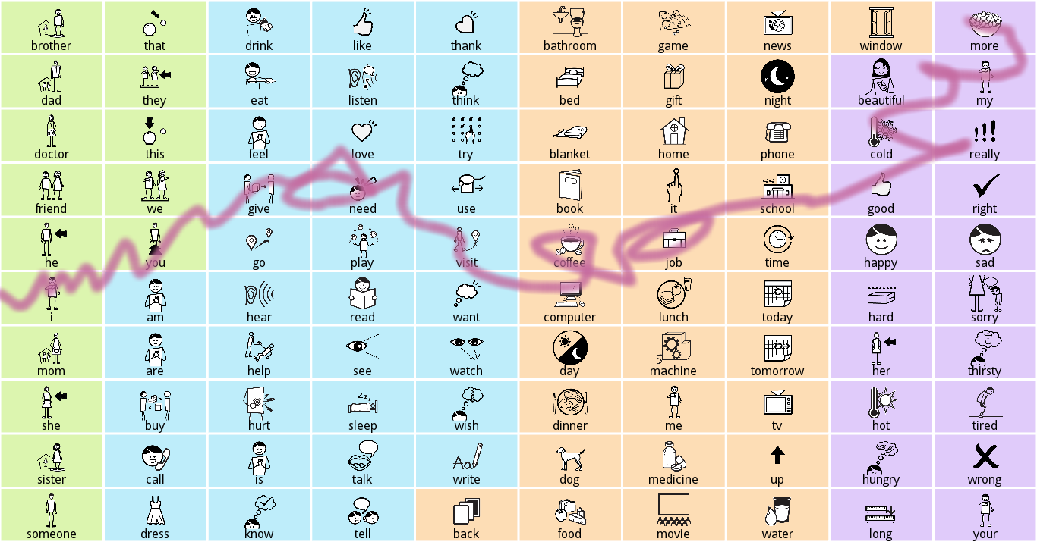
SymbolPath
"I need more coffee"

Slide 85
Summary of SymbolPath
Designed for people with upper limb motor impairments or developing literacy
Semantic grams reweighted by path contour
75+ active users on Android
Regular email feedback: "It's fun!"
Drawing and syntactic completion/generation encourages fuller utterances

Slide 86
Applied Contributions
RSVP-iconCHAT
Free Order,
Discrete Icons
SymbolPath
Free Order,
Continuous Icons
DigitCHAT
Mobile, Mixed-Input Letters

Slide 87
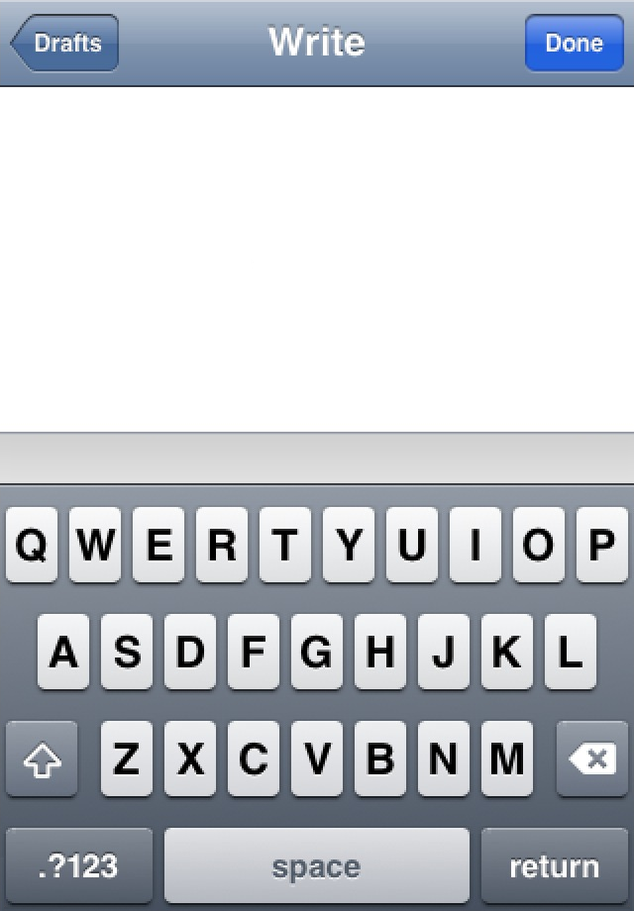
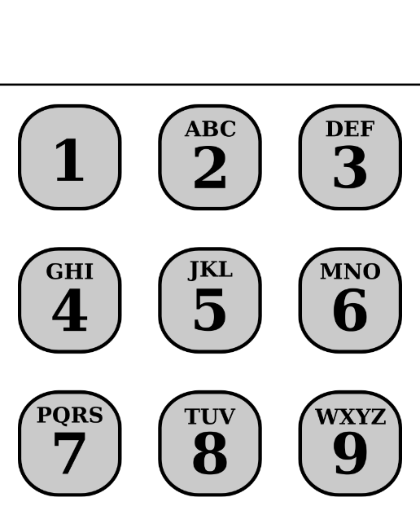
DigitCHAT Motivation

Slide 88
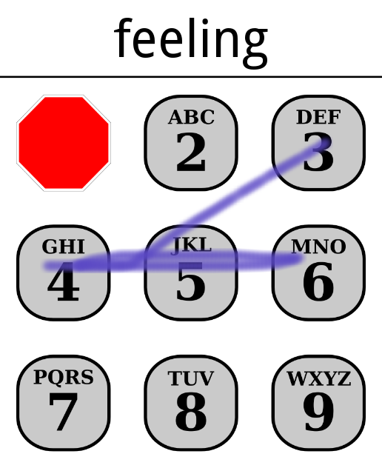
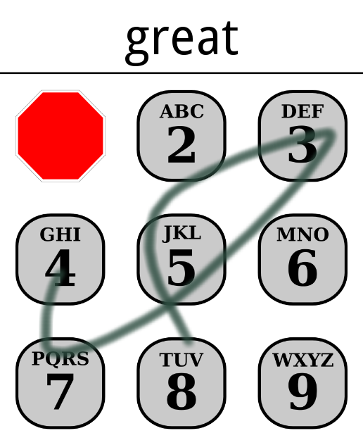
DigitCHAT
Word-by-word, real-time construction
Mixed-mode input and active learning

Slide 89
Summary of DigitCHAT
Scalable and fast (> 45 WPM) [Silfverberg et al, 2000]
Compare to < 20 WPM for most AAC systems
15+ active users on Android
Winner of the ACM ASSETS 2014 Text Entry Challenge

Slide 90
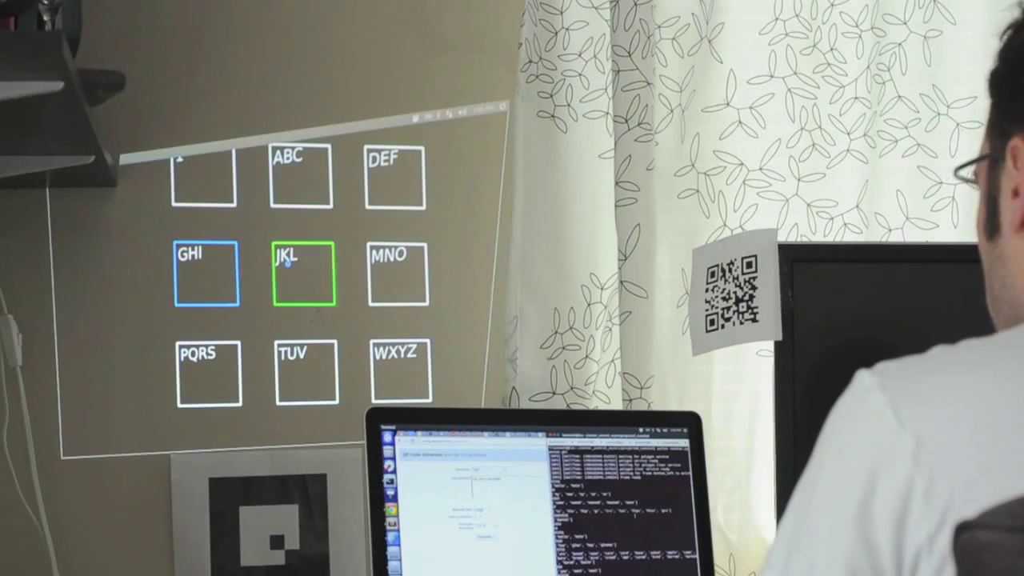
Projected DigitCHAT
Head-tracking prototype by Dan Lazewatsky and Bill Smart
(Oregon State University)

Slide 91
Part 4:
Summary
and
Conclusion

Slide 92
Thesis (Redux)
"Intelligent interfaces can mitigate the need for linguistically and motorically precise user input to enhance the ease and efficiency of assistive communication."

Slide 93
Theoretical Contributions
"...mitigate the need for linguistically and motorically precise user input..."
An unordered language model that bridges syntax and semantics. [Wiegand and Patel, 2012A]
An empirical comparison of contextual language predictors. [Wiegand and Patel, 2015B (R1)]
A motor movement study with current and potential AAC users. [Wiegand and Patel, 2015A]

Slide 94
Applied Contributions
"...to enhance the ease and efficiency of assistive communication."
A semantic approach to icon-based, switch AAC. [Wiegand and Patel, 2014B]
A continuous motion overlay module for icon-based AAC. [Wiegand and Patel, 2012B]
Mobile, letter-based AAC that supports conversational speeds. [Wiegand and Patel, 2014A]

Slide 95
Revisiting the Goal

Slide 96
Revisiting the Goal

Slide 97
Thank you for listening! karlwiegand.com/defense
Special thanks to the Continuous Path Foundation and the National Science Foundation (Grants #HCC-0914808 and #SBE-0354378).

Slide 99
Sem-Grams: Method Details
Test sentences truncated to 20 words
All algorithms seeded with top 10 type-specific grams for each input word
Maximum of 190 candidate words to rank
Absence of target word in list was considered a "failure to predict"

Slide 100
Sem-Grams: Overview of Results
 | N1 | N2 | S1 | S2
# of Sentences | 2000 | 2000 | 2000 | 2000
# Predicted | 647 | 649 | 435 | 435
Average Score | 16.26 | 19.70 | 9.04 | 12.67

Slide 101
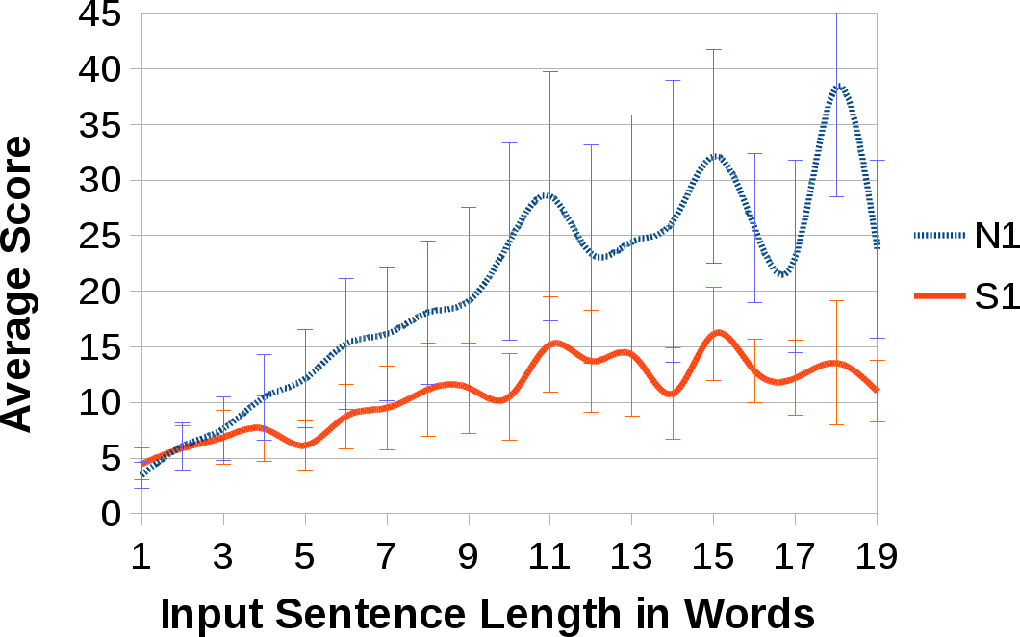
Sem-Grams: Performance

Slide 102
Context: Method Details
Predictor | Blog Authorship | Yelp
Age | 26 | -
Gender | 2 | -
Day of the Week (DOW) | 7 | 7
Day of the Month (DOM) | 31 (4) | 31 (4)
Month | 12 | 12
City | - | 119
State | - | 16
Average of 18 unique contexts per author in Blog Authorship and 4 in Yelp Dataset

Slide 103
MoGUI: Observations
Varied tablet and hand/arm positions
Tablet being held, flat/tilted on lap, on desk, tilted on table, held in wheelchair mount
Use of fingers, thumb, stylus, and knuckles
Ghost tapping, spastic tapping, stylus friction, and finger humidity
Repeated margin activation and triggering of Google Now functionality

Slide 104
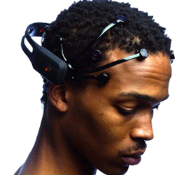
Brain-Computer Interfaces (BCI)
http://www.emotiv.com/
http://www.neurosky.com/
Notes:
Emotiv Epoc on the left and Neurosky's MindWave on the right

Slide 105
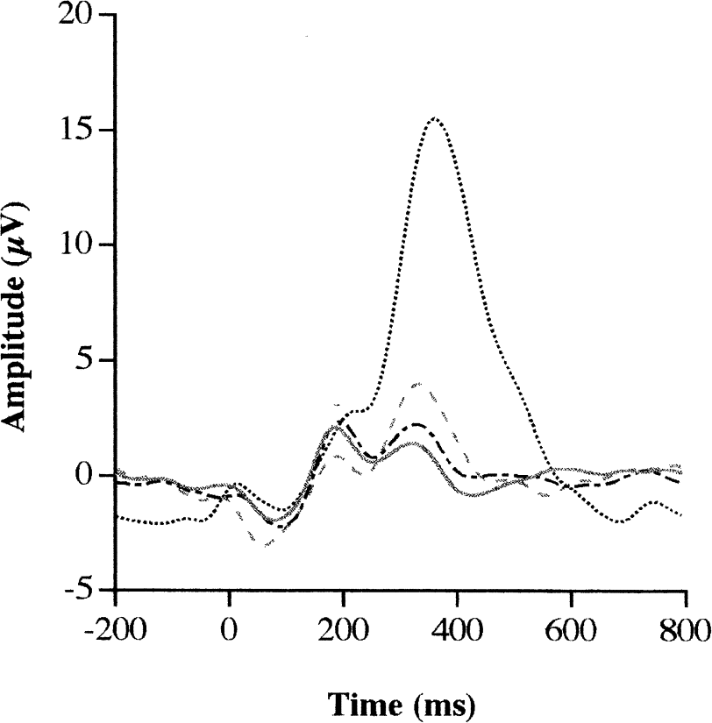
The P300 Wave

Slide 106
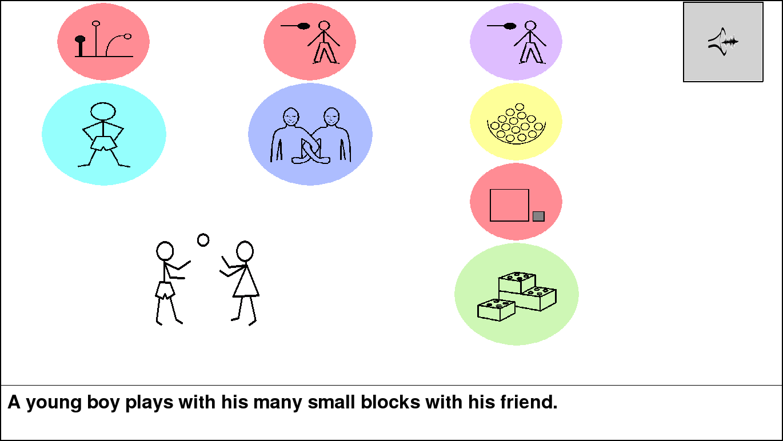
Complexity vs. Real Estate

Slide 107
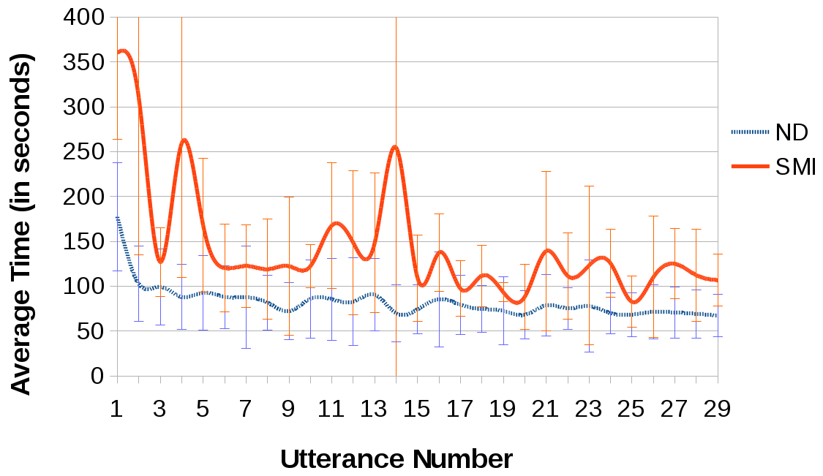
RSVP-iconCHAT: Construction Time

Slide 108
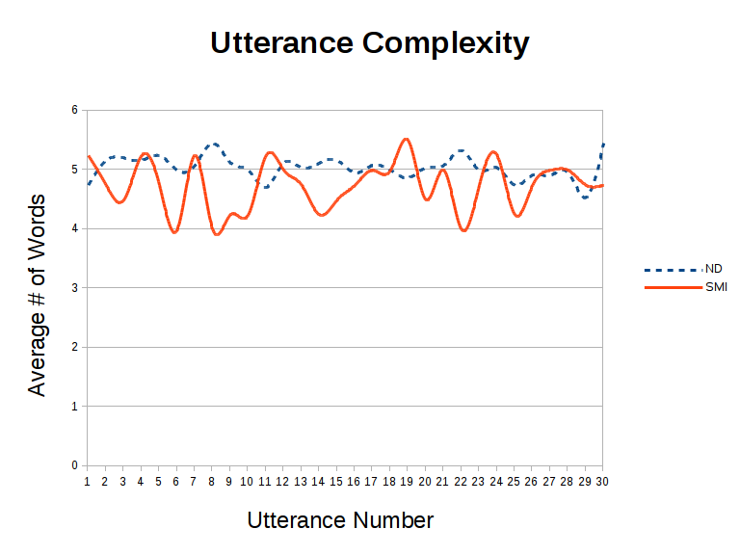

Slide 109
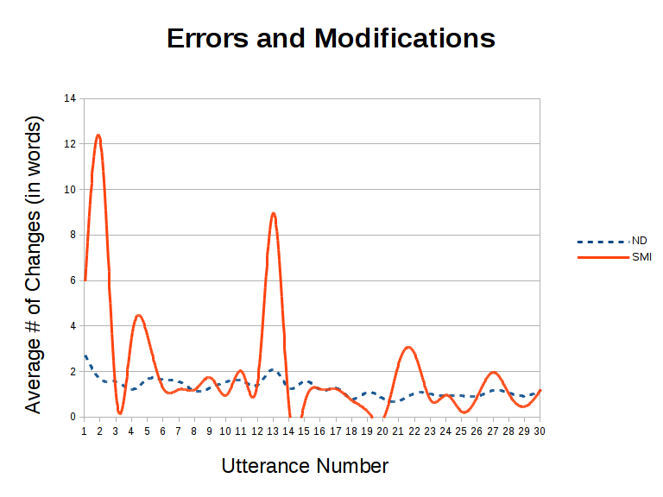

Slide 110
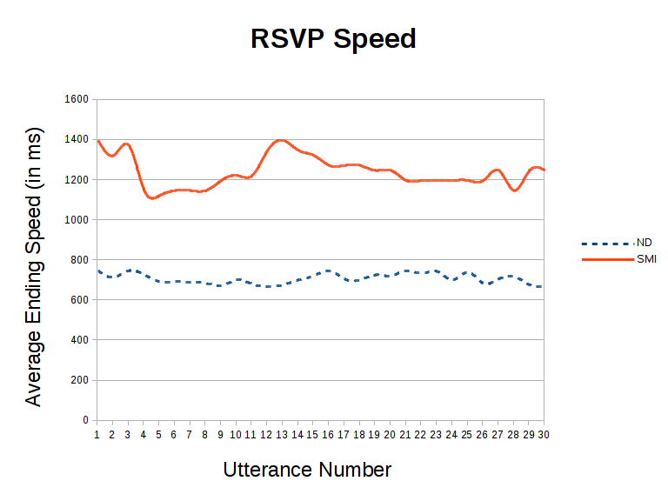

Slide 111
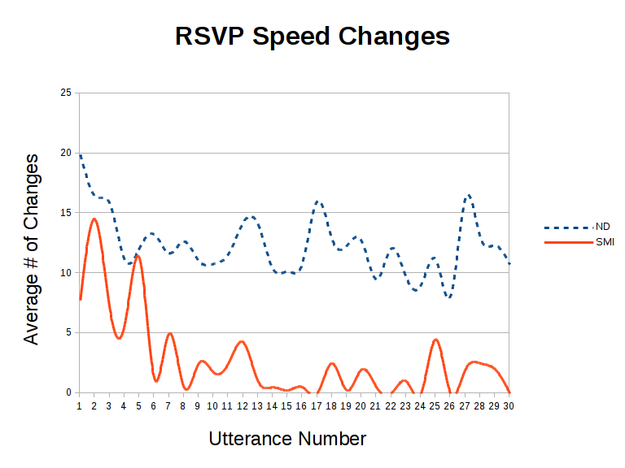

Slide 112
RSVP-iconCHAT: Feedback
All users get restless w/ alphabetic ordering
Even alphabetic ordering can be surprising
All users with SMI asked about other switches and multi-modal methods
All users favorably mentioned the automatic syntax generation/modification

