Slide 1
Impact of Motor Impairment on Full-Screen Touch Interaction
karlwiegand.com/csun2015
Karl Wiegand and Rupal Patel
Northeastern University (USA)
March 6, 2015

Slide 2
Outline
Touchscreens and Accessibility
Study Description
Results and Observations
Summary and Conclusions

Slide 3
Touchscreen Prevalence
First appeared in 1960s and 1970s (Johnson; Beck and Stumpe; Hurst)
In mobile devices since 1990s (IBM Simon)
Popularity exploded in 2007 w/ iPhone
Apple sold 1.12+ million iPhones in 2007
Now in almost every mobile device

Slide 4
Touchscreen Accessibility
Motor impairment from MS, MSA, MD, etc.
Can rebind gestures or create new ones
Adjust click timing; enable switch control
Avoid touch interaction (e.g. Siri or Now)

Slide 5
Common Limitations
Programmatically prohibited from toggling or adjusting sliding functionality
Users are prevented from modifying the location, size, shape, and orientation of many toolbars and buttons
Difficult to quantify the effects of these limitations on users and purchasing

Slide 6
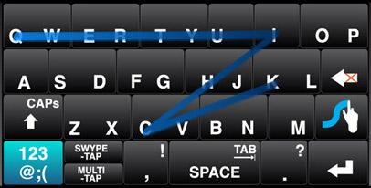
Motivating Example: Swype
Originally conceived as an interface for assistive communication
Well-received by non-disabled users

Slide 7
Motivating Questions
Most mobile devices now have touchscreens
Increasing research on accessibility
Fitts and Steering Laws [Fitts, 1954; Accot and Zhai, 1996]
Swabbing/sliding is easier [Wacharamanotham et al, 2011]
Buttons need to be bigger [Chen et al, 2013]
What about functional compensation?
Can we learn realistic, layout-agnostic interaction patterns for an individual user?

Slide 8
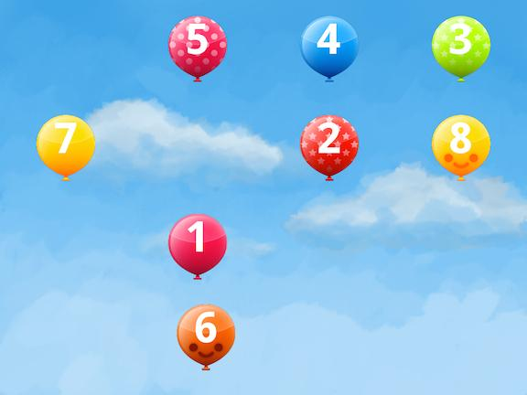
Motor Optimization GUI (MoGUI)

Slide 9
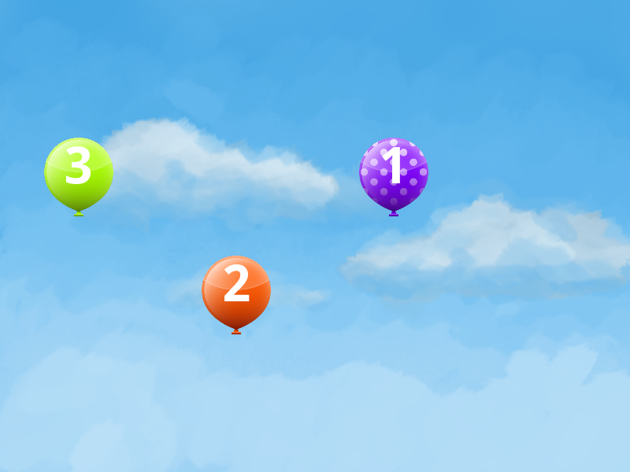
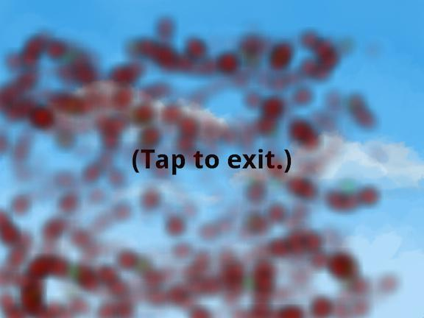
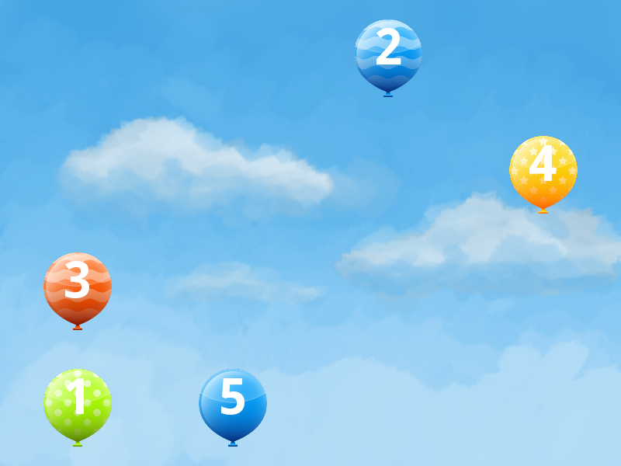
MoGUI Example

Slide 10
Study Overview
2 cross-balanced sessions: taps vs. slides
4x4 grid = 16 locations
Pseudo-random shuffling (a la Latin Squares)
10 levels of 3 rounds each
1, 2, 3, ...10 balloons per round = 165 total
Track all hits, misses, and timing

Slide 11
Participants
Residents at the Boston Home
Various levels of speech and motor impairments
10 females and 5 males
Ages 35 - 71 (mean of 56)
8 right-handed; 7 left-handed (3 due to MS)
All were familiar with touchscreen tablets, but only 8 regular users (7 iPads, 1 Kindle)

Slide 12
Method
10.1" Android tablet (ASUS Transformer)
Comfortable, landscape position s.t. all areas were fully reachable
9 users preferred a 45-degree angle on a table
1 user preferred a lowered table and flat tablet
2 users preferred the tablet in a wheelchair mount
2 users preferred the tablet in their lap
1 user cradled the tablet in one arm
Choice of finger or stylus
6 wanted stylus, but needed it positioned

Slide 13
Interview Questions
Did you find any areas of the screen easier or more difficult to reach than others?
Did you prefer tapping, sliding, a combination of both, or neither?
Were the balloon targets too big or small?
What would you like to see improved in touchscreen tablets?

Slide 14
Variability: Multiple Taps (LH)

Slide 15
Variability: Finger Dragging (RH)

Slide 16
Variability: Hand Resting (RH)

Slide 17
Variability: Thumb Usage (RH)

Slide 18
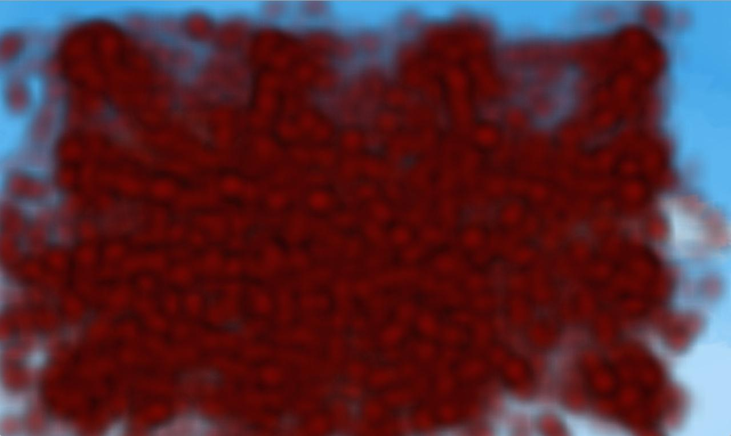
Results: Misses by Handedness
Left
Right
Overlays from all sessions

Slide 19
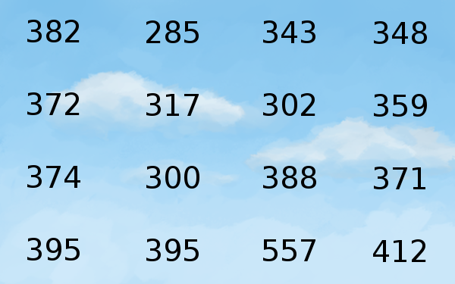
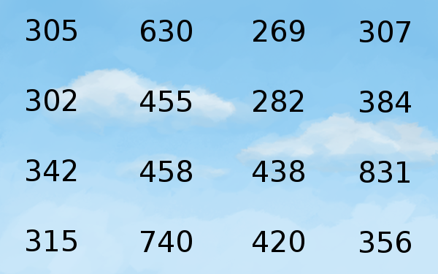
Results: Locations by Handedness
Left
Right
Mean speed-to-target in pixels/second

Slide 20
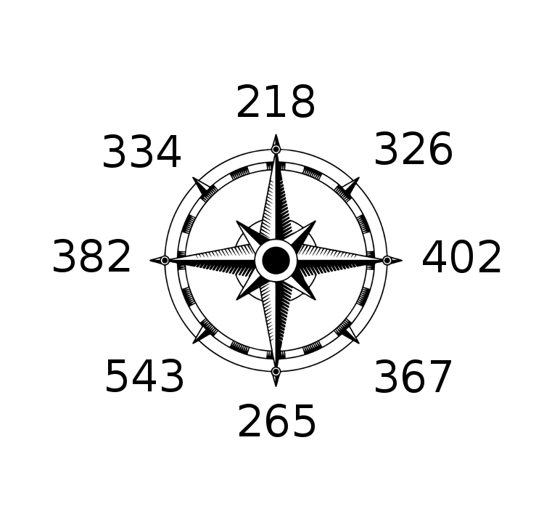
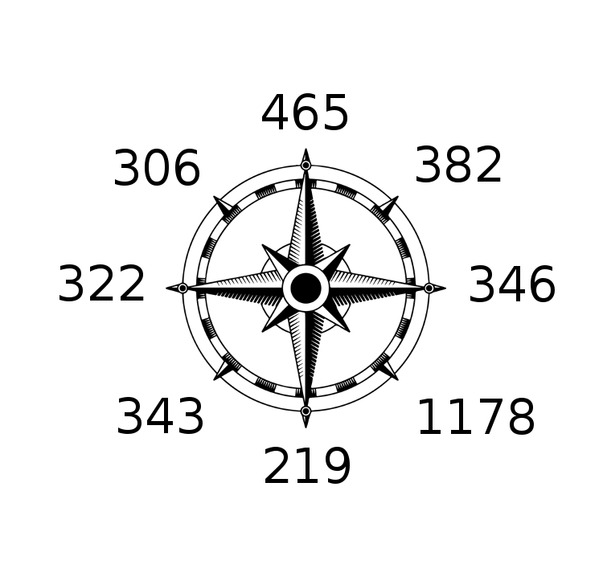
Results: Directions by Handedness
Left
Right
Mean speed-to-target in pixels/second

Slide 21
Participant Feedback
3 users preferred tapping; 5 preferred sliding; 5 preferred a combination of both; and 2 had no preference
10 users noted that sliding required planning
Overall, 8 participants felt that sliding felt "faster" and "easier," but for short distances
Randomness prevented motor learning

Slide 22
Study Observations
Varied tablet and hand/arm positions
Tablet being held, flat/tilted on lap, on desk, tilted on table, held in wheelchair mount
Needed to disable auto-rotation for 1 user
Use of fingers, thumb, stylus, and knuckles
Ghost tapping, spastic tapping, stylus friction, and finger humidity
Repeated margin activation and triggering of Google Now functionality

Slide 23
Summary
Sliding not significantly faster than tapping for arbitrary targets; no motor learning
16% accidental slides; 43% accidental taps
High variance in individual motor patterns; weak correlations by handedness
Gamified calibration
Static improvements through personas:
Handedness → margins, button locations
Tap/slide preferences → input sensitivity

Slide 24
Thank you for listening! karlwiegand.com/csun2015
Special thanks to the Continuous Path Foundation and the National Science Foundation (Grants #HCC-0914808 and #SBE-0354378).

