Slide 1
Pre-Presentation Notes
Slides and presentation materials are available online at:
karlwiegand.com/csun2014

Slide 2
RSVP-iconCHAT:
A Single-Switch, Icon-Based
AAC Interface
Karl Wiegand
Rupal Patel, Ph.D.
Northeastern University (USA)
March 1, 2013

Slide 3
Outline
The Vision
Background and Scope
Approach
Evaluation
Results

Slide 4
Part 1:
The Vision

Slide 5
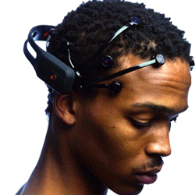
Brain-Computer Interfaces (BCI)
http://www.emotiv.com/
http://www.neurosky.com/

Slide 6
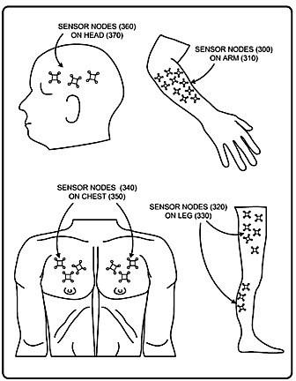
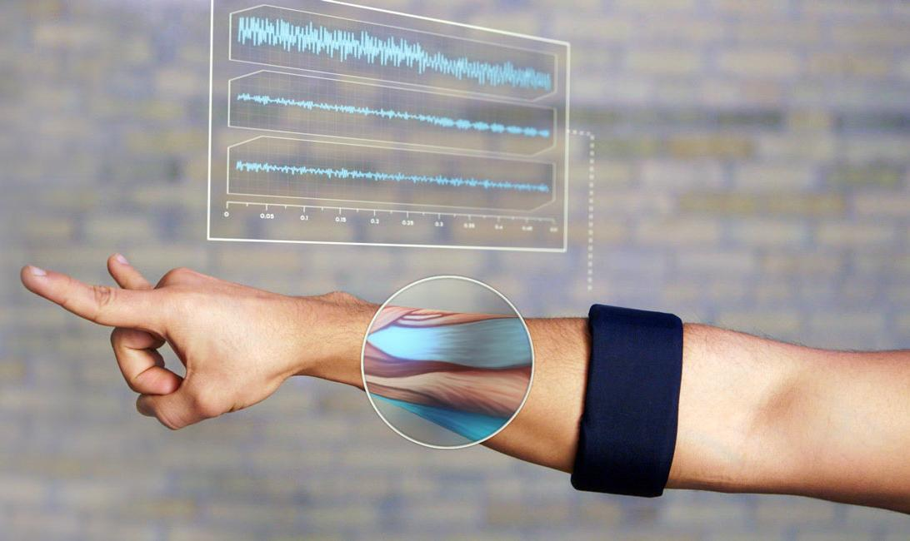
Muscle-Computer Interfaces (MuCI)
http://www.thalmic.com/en/myo/
http://research.microsoft.com/en-us/um/redmond/groups/cue/MuCI/

Slide 7
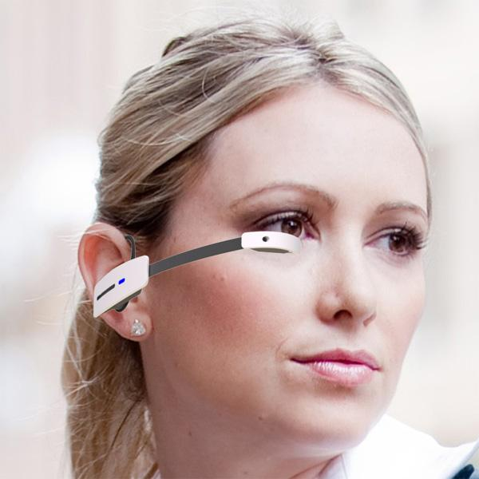
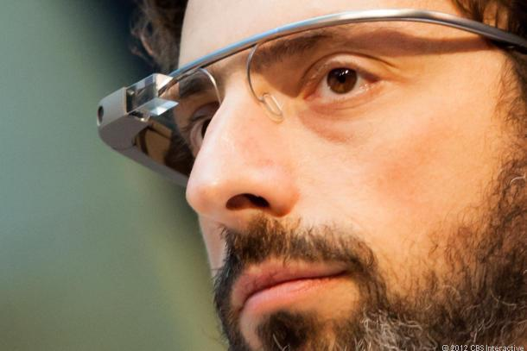
Wearable Computing Systems
http://www.vuzix.com/consumer/products_m100/
http://www.google.com/glass/

Slide 8
How can we think about
the future of AAC interfaces?

Slide 9
Part 2:
Background
and Scope

Slide 10
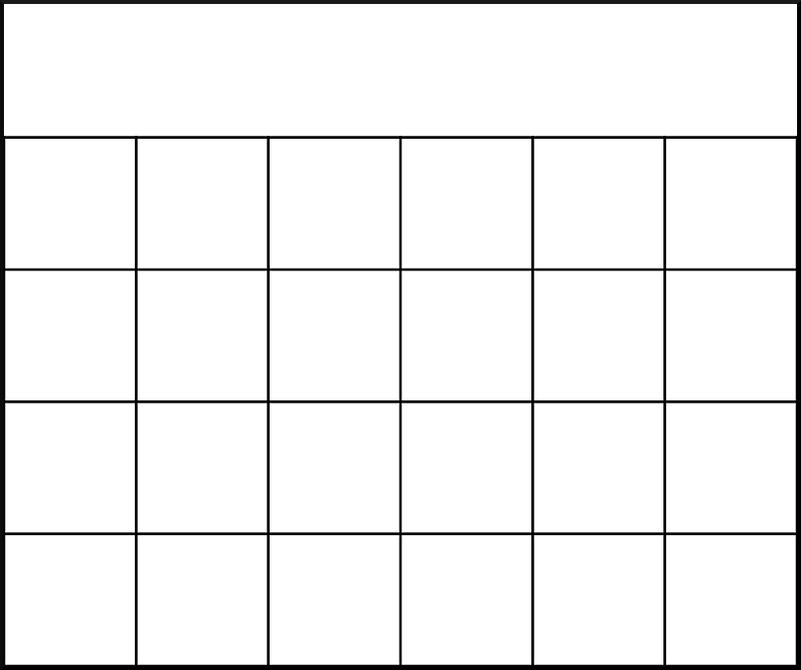
Current AAC Interfaces

Slide 11
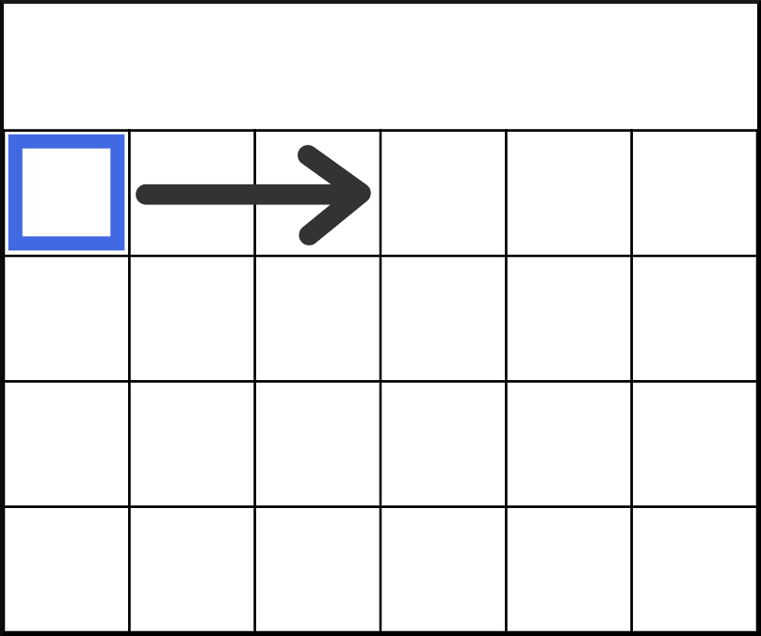
Conversion to Single-Switch

Slide 12
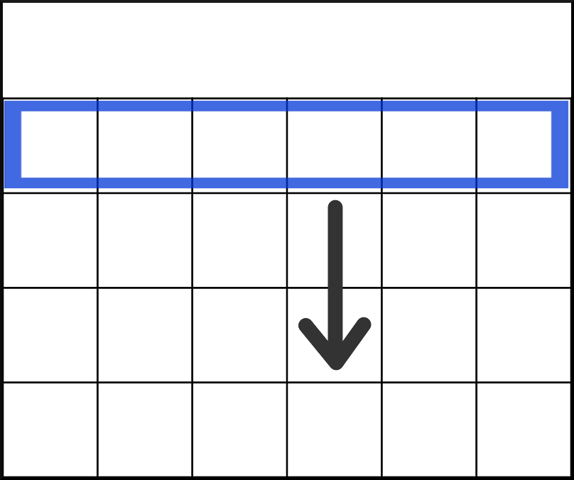
Row-Column Scanning

Slide 13
Observations
Maintains familiarity.
Focus is on the vocabulary.
Required screen size is tied to vocabulary size or navigation complexity.
Users usually perform the search twice.
Searches involve repetitive movements.

Slide 14
Our Collaborative Effort
Creation of a icon-based, BCI-controlled AAC system
NSF Grant HCC-0914808
Jointly investigated:
Dr. Deniz Erdogmus (ECE)
Dr. Rupal Patel (SLPA and CCIS)
BCI uses P300 brainwave (unary signal)

Slide 15
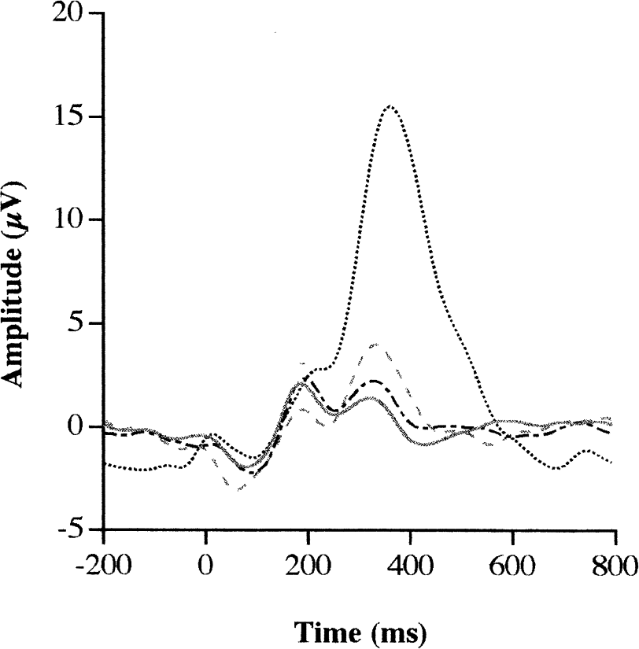
The P300 Wave

Slide 16
Requirements and Scope
Based on icons, not letters:
Some letter-based BCI systems exist.
Icons have the potential to be faster.
Users may be pre-literate or have language impairments.
Minimize head, neck, and eye movements:
Movement can dislodge the BCI equipment.
Work with a unary signal (P300):
Expand to support other signals if available.

Slide 17
Part 3:
Approach

Slide 18
Driving Questions
How can we decouple the required screen size from the vocabulary size?
Can we focus on the message instead of the vocabulary?
How much work can be shifted from the user to the system?

Slide 19
Idea #1: RSVP
Rapid Serial Visual Presentation
Used in psychology, speed-reading, lie detection, and prior letter-based AAC
Orhan, U., II, K. E. H., Erdogmus, D., Roark, B., Oken, B. & Fried-Oken, M. (2012). RSVP keyboard: An EEG based typing interface.. In ICASSP (pp. 645-648) . IEEE . ISBN: 978-1-4673-0046-9

Slide 20
Idea #2: Semantic Frames
Semantic frames, CxG, and PAS (Fillmore)
To Give ( Agent, Object, Beneficiary )"I gave the item to him." "The item was given to him by me."
WordNet, FrameNet, "Read the Web," NELL
Easier to convert from semantic to surface

Slide 21
RSVP-iconCHAT

Slide 22
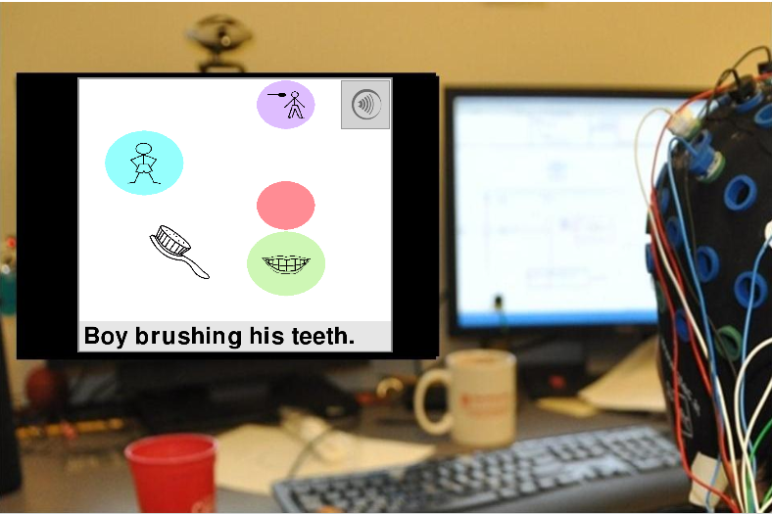
Example Usage
Wiegand, K., Patel, R., & Erdogmus, D. (2010). Leveraging Semantic Frames and Serial Icon Presentation for Message Construction. ISAAC Conference for Augmentative and Alternative Communication, Barcelona, Spain, July 2010.

Slide 25
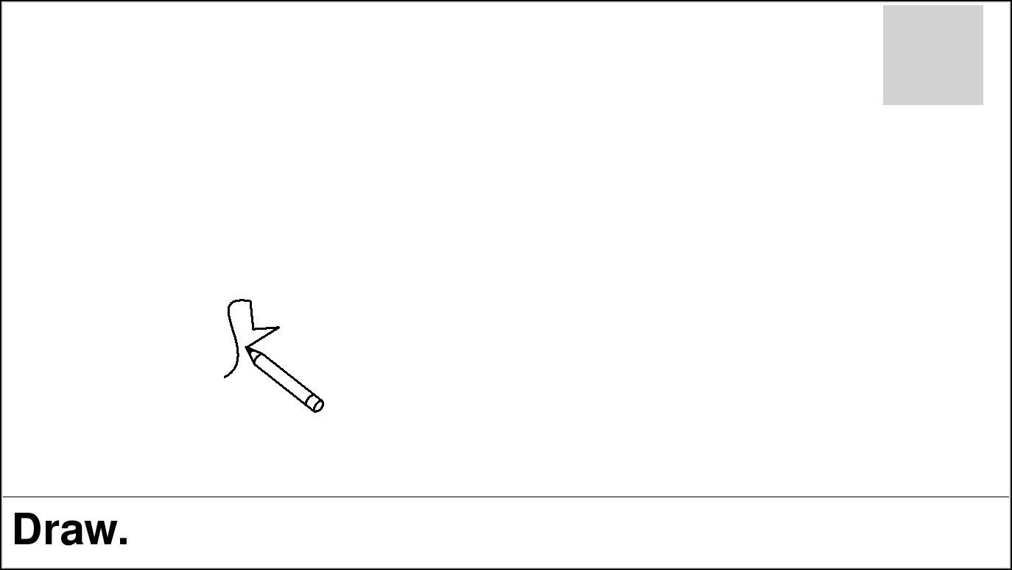

Slide 26
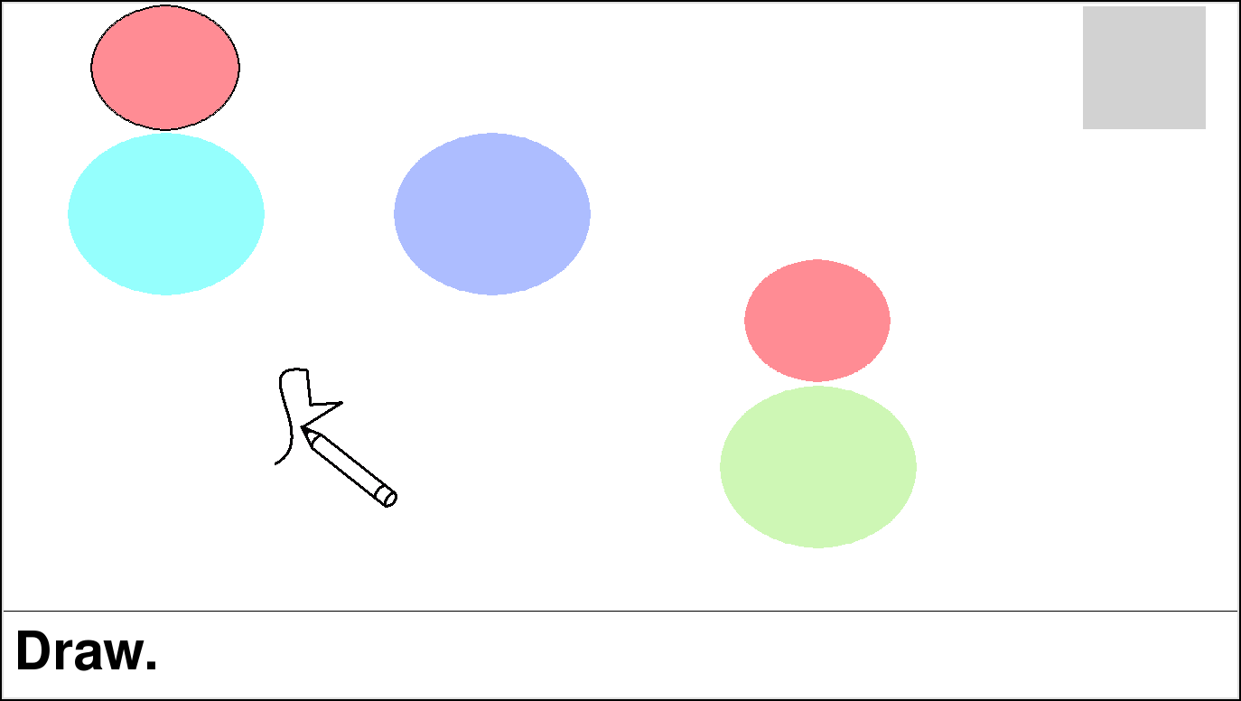

Slide 27
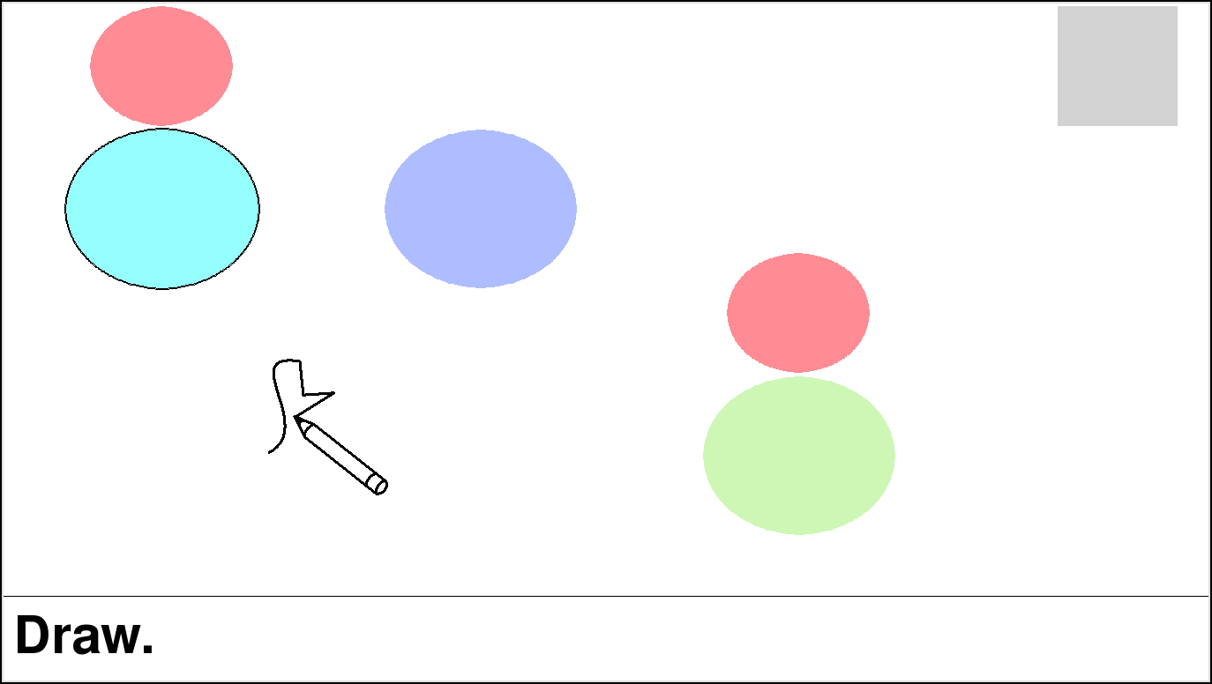

Slide 29
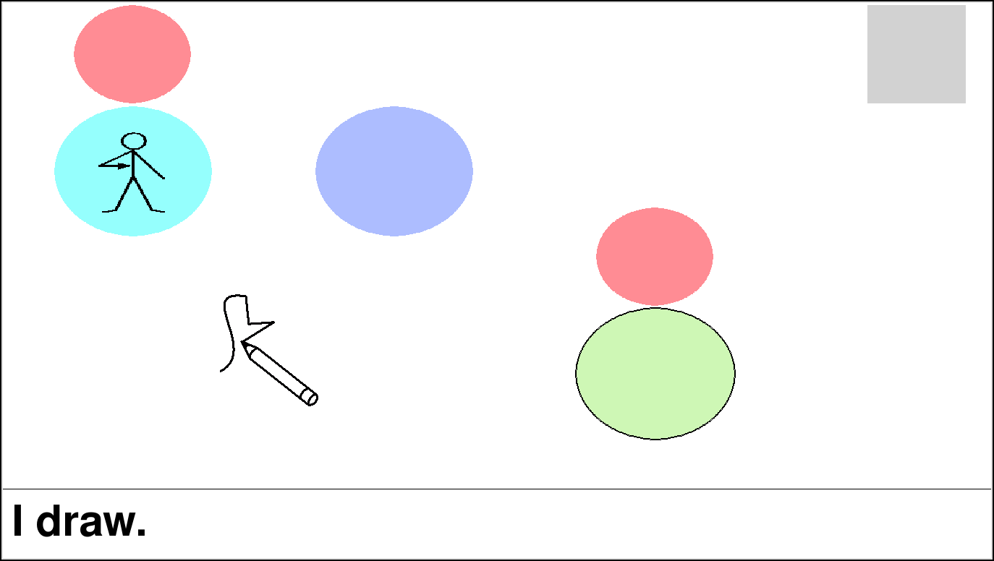

Slide 30
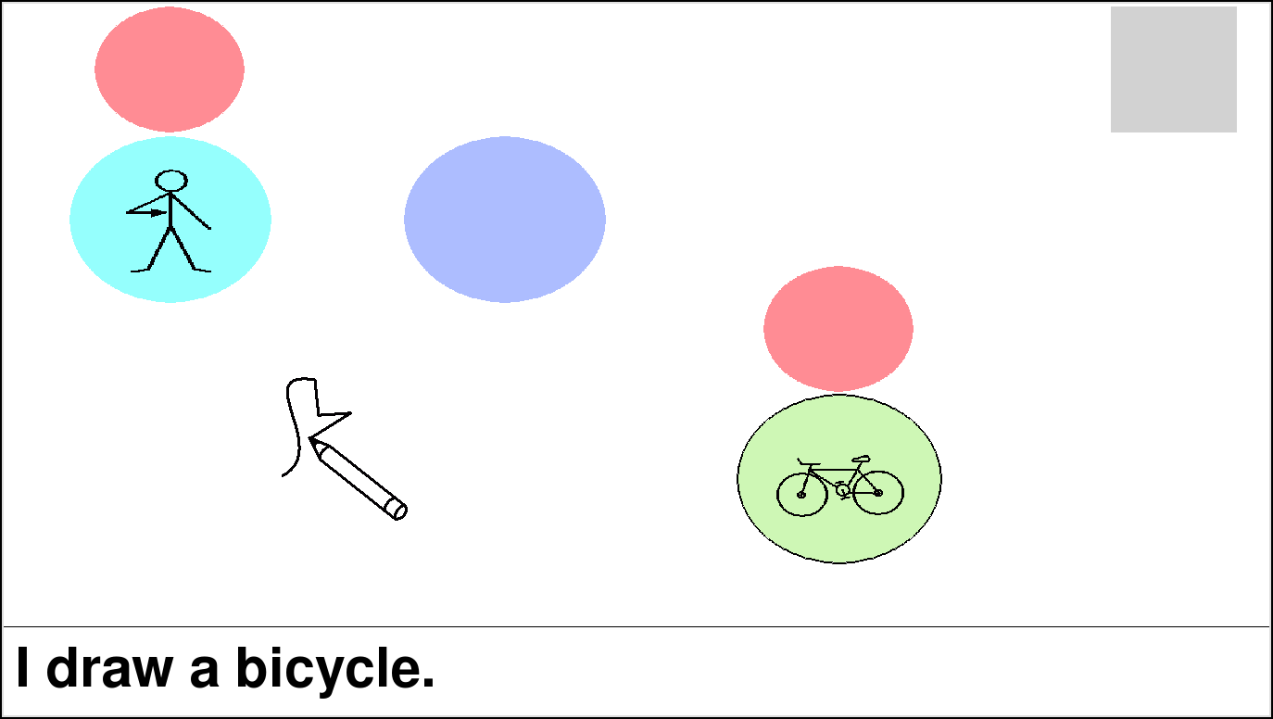

Slide 32
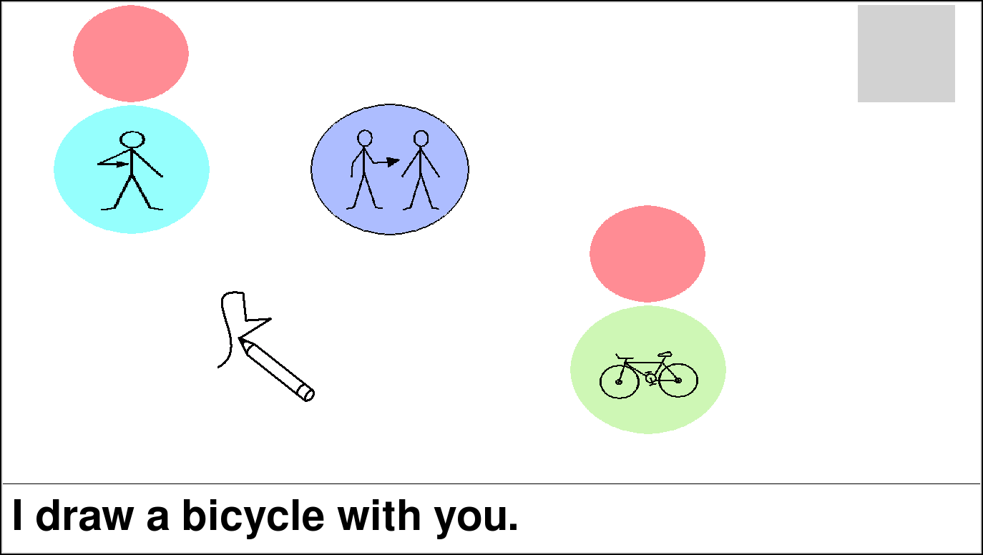
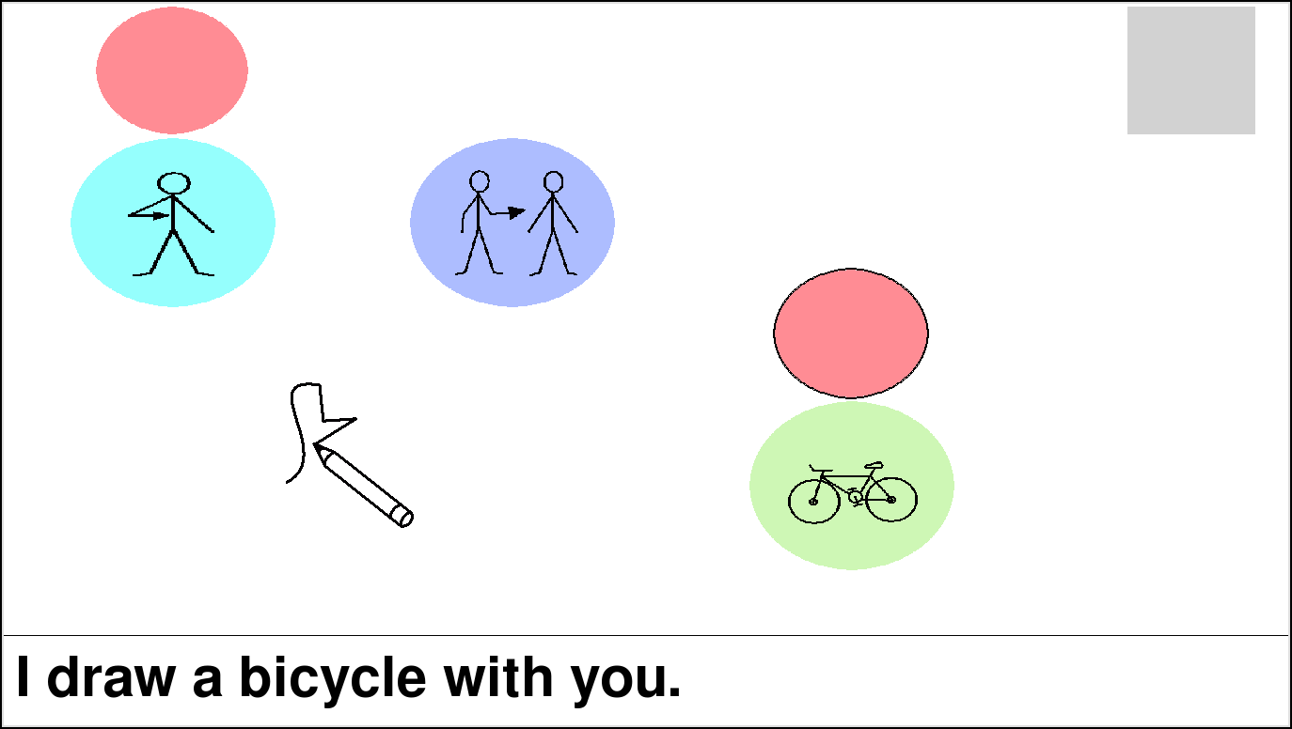

Slide 33
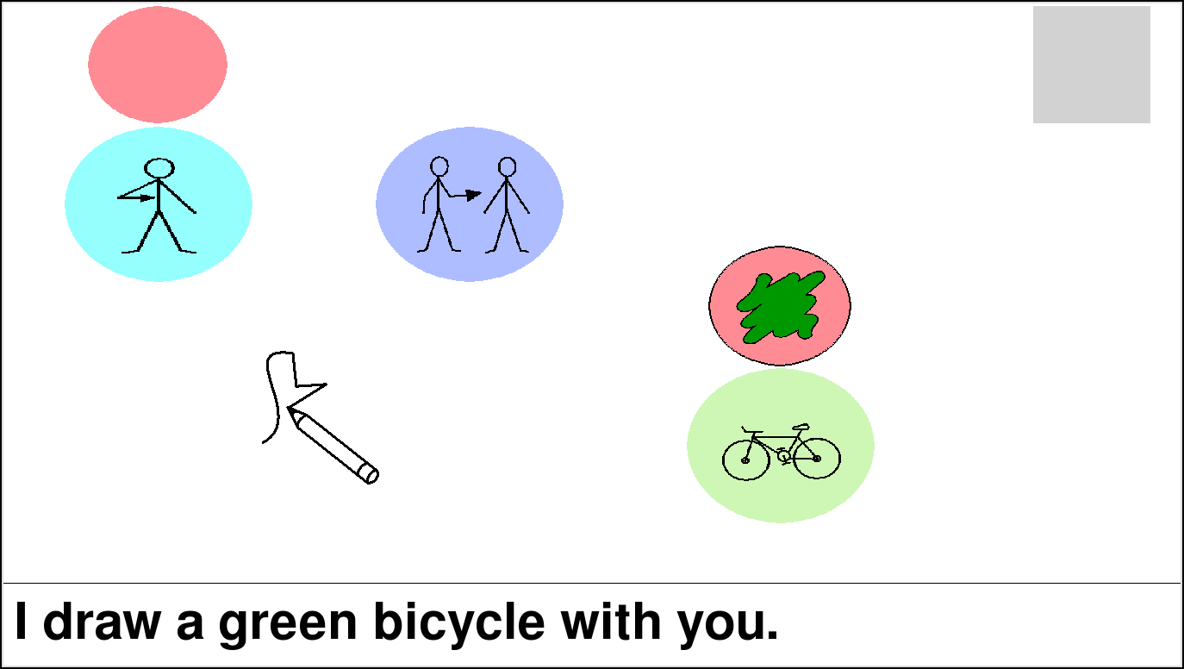

Slide 34
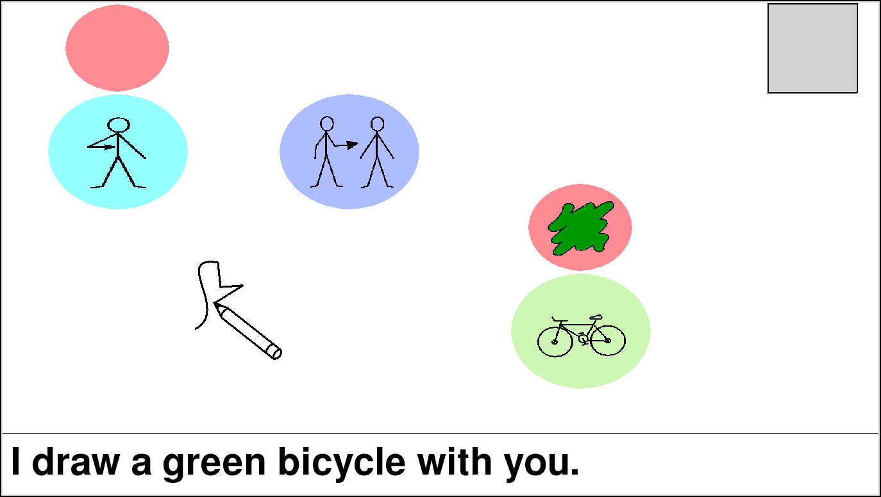

Slide 35
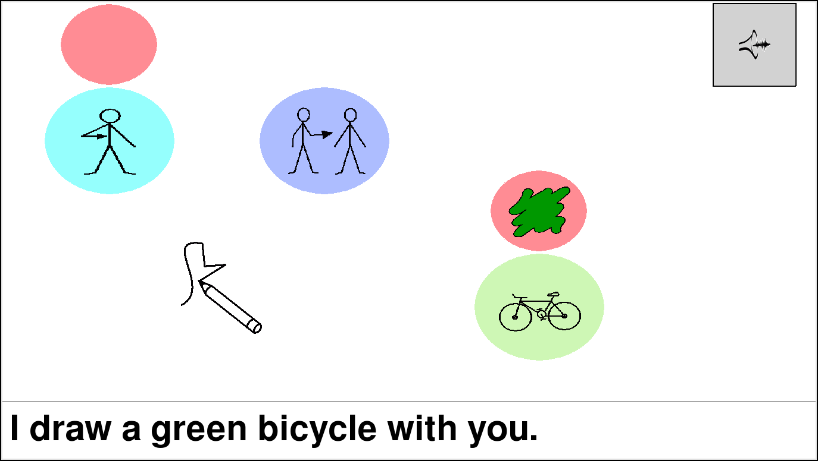

Slide 36
Characteristics
De-emphasized textual representation
Semantic frames can be populated in any order
Configurable switch modality
Configurable ordering patterns
Configurable frame complexity

Slide 37
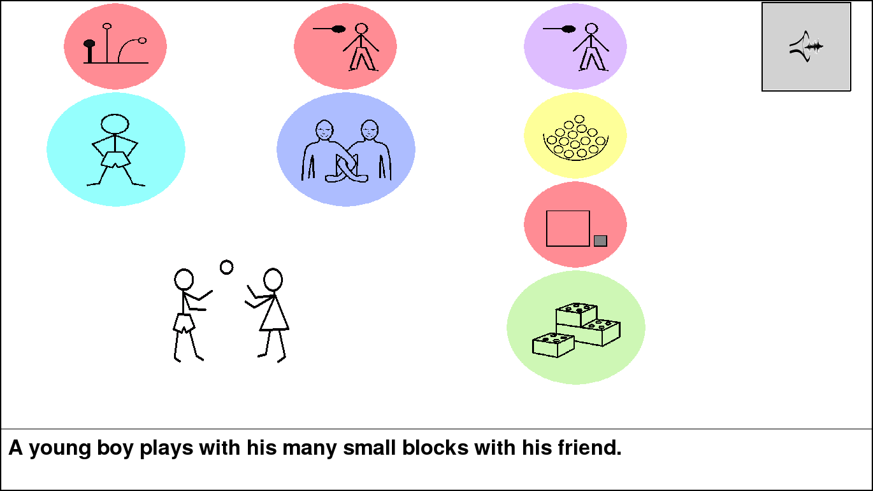
Complexity vs. Real Estate

Slide 38
Observations
Required screen space is now tied to message complexity.
Full vocabulary is hidden/filtered.
Prediction/ordering controls speed of construction.
Some classifications are tricky -- where should illocutionary acts (e.g. small-talk) go?

Slide 39
Part 4:
Evaluation

Slide 40
User Group #1: "ND"
Non-disabled (ND), to provide a theoretical upper bound on performance
24 English-speaking adults
10 males and 14 females
Ages 19 - 43 (mean of 24)

Slide 41
User Group #2: "SMI"
Speech and motor impairments (SMI)
Ages 33 - 56 (mean of 41)
ID | Sex | Motor | Speech | Mode
P1 | F | Mild | Mild | Unaided
P2 | M | Mild | Moderate | Unaided
P3 | F | Moderate / Severe | Mild | Unaided and Switch
P4 | M | Severe | Severe | Caregiver

Slide 42
Constrained Message Elicitation
More open-ended than "copy phrase"
More comparable than real-world usage
Closed vocabulary controlled via single-action picture cards

Slide 43
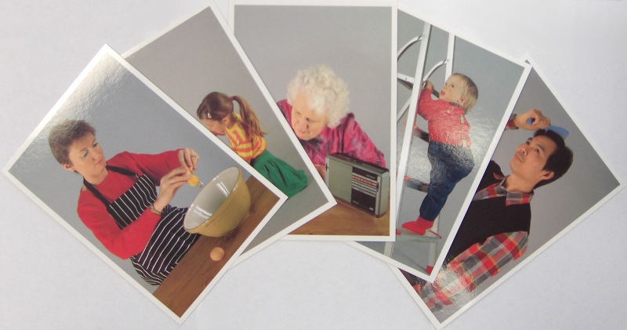
Example Picture Cards

Slide 44
Study Setup
30 shuffled cards per person
Space bar as switch
Starting RSVP speed of 700ms
Adjustable by +/- 100ms
106 words tagged in up to 8 roles
Unlimited time and alphabetic ordering

Slide 45
Part 5:
Results

Slide 46
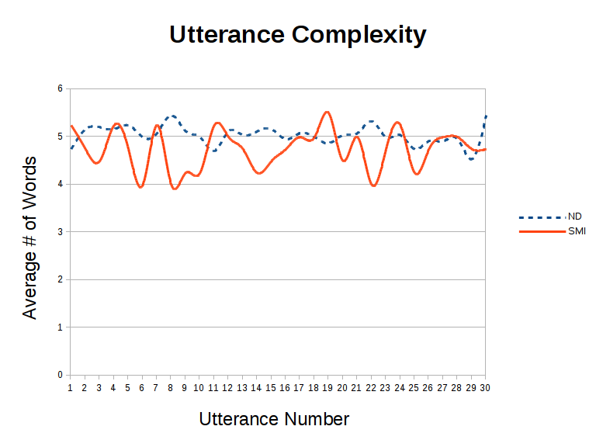

Slide 47
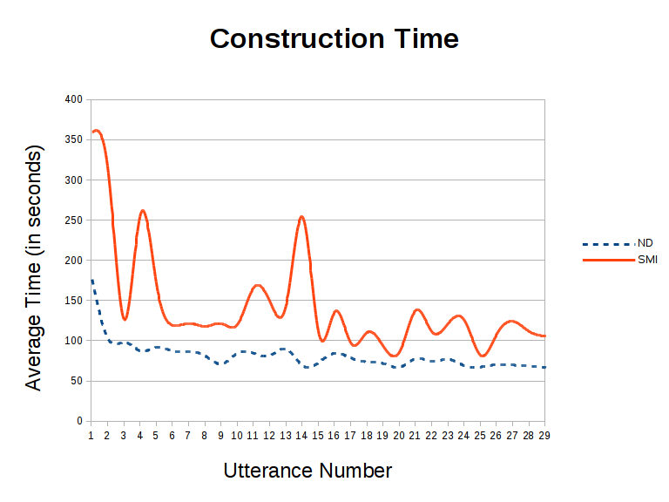

Slide 48
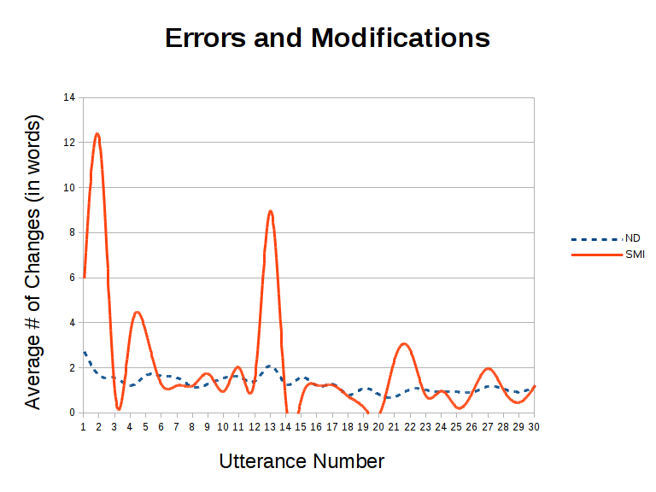

Slide 49
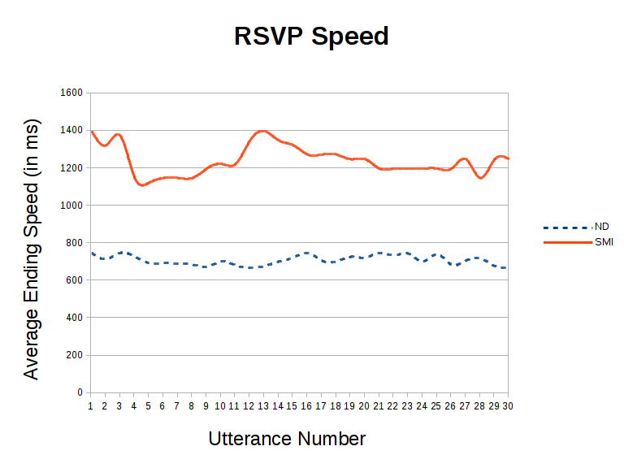

Slide 50
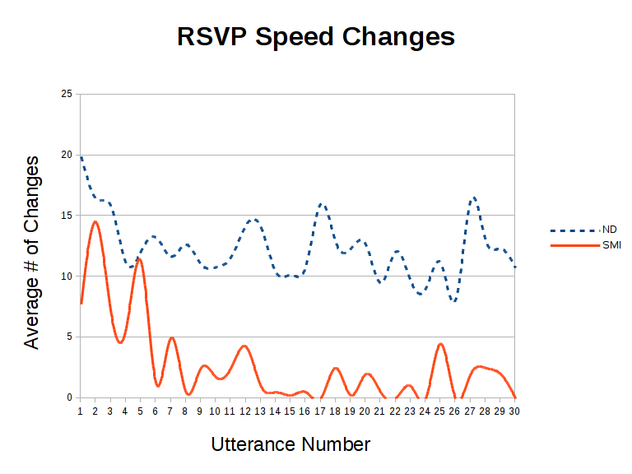

Slide 51
Quantitative Summary
No nonsensical utterances
Average of 5 selections (verb + 4)
Average speed of last 5 utterances:
70s (ND) vs. 107s (SMI)
RSVP speeds w/ positive motor response:
700ms (ND) vs. 1200ms (SMI)
Similar learning curves for both groups
Mid-experiment errors may have been exploration

Slide 52
Qualitative Feedback
All users get restless w/ alphabetic ordering
Even alphabetic ordering can be surprising
Numerous users asked about other switching methods and multi-modal adaptations
Numerous users favorably mentioned the automatic syntax modification/correction

Slide 53
Epilogue:
Closing Thoughts

Slide 54
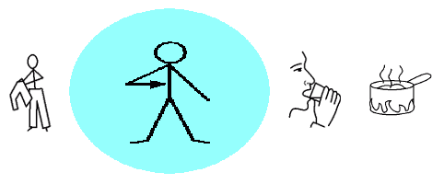
Potential Improvements
Slow down near more likely words
Filter unlikely words based on frames
Skip to more likely alphabetic positions
Carousel:

Slide 55
Current Applications
Small-screen and mobile systems
Perhaps combined with a hand-held controller
Multi-modal or analog input combinations:
Push the switch harder to go faster
Directional switches
"Oops" functionality
Involuntary responses: muscle twitch, BCI
Can then leverage predictive reordering
Initial results expected later this year

Slide 56
Thank you for listening!
karlwiegand.com/csun2014
Thanks to Dr. Rupal Patel, Dr. Deniz Erdogmus, and the National Science Foundation (Grant #0914808).

