Slide 1
Pre-Presentation Notes
Slides and presentation materials are available online at:
karlwiegand.com/csun2013

Slide 2

CSUN 2013:
Novel Approaches to
Icon-Based AAC
Karl Wiegand
Rupal Patel, Ph.D.
Northeastern University
March 1, 2013
Notes:
My name is Karl Wiegand, and I'm a Ph.D. student in computer science at Northeastern University...

Slide 3
Outline
Why Icons?
Current Systems and Questions
SymbolPath
RSVP-iconCHAT
How You Can Help

Slide 4
Why Icons?
Bad:
Not fully generative
Vocabulary requires screen space
Letter-based research is often inapplicable
Good:
Supports limited recall
Doesn't require literacy
Often faster
Notes:
...and why is speed so important?

Slide 5
On Speed of Communication
Typical AAC is < 20 words per minute
vs.
Speech is often 150 - 200 words per minute
Higginbotham, D. J., Shane, H., Russell, S., & Caves, K. (2007). Access to AAC: present, past, and future. AAC: Augmentative & Alternative Communication, 23 (3), 243-257.

Slide 6
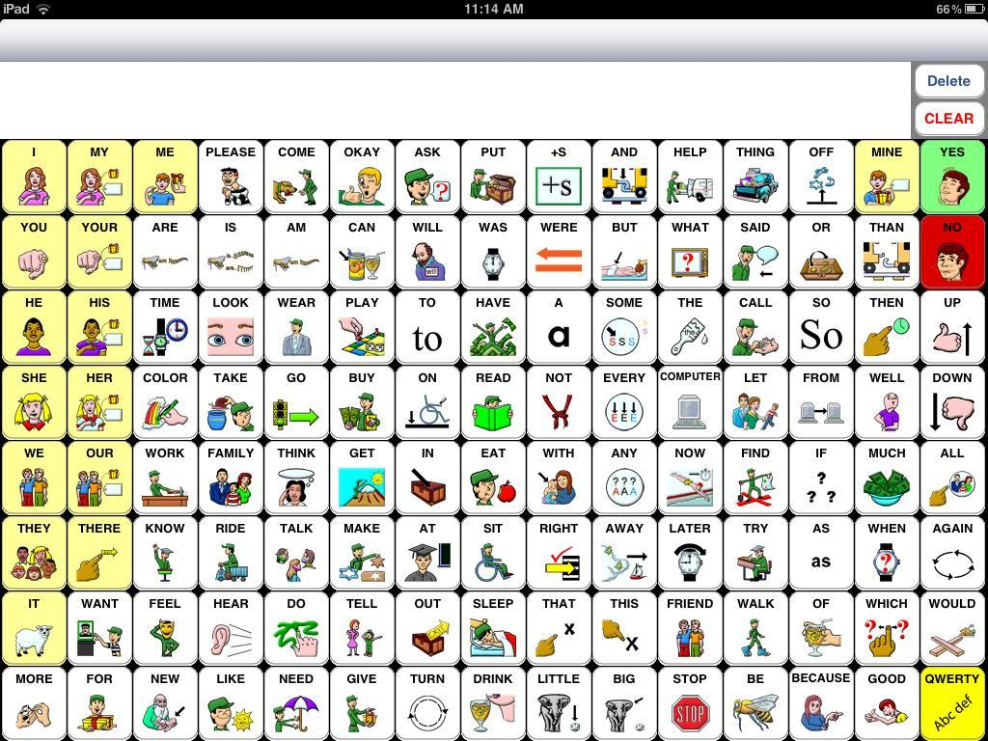
Current Icon-Based AAC
http://www.speakforyourself.org/
Notes:
This is SpeakForYourself, a modern, icon-based AAC application for Android and iOS. I should note that I'm not affiliated with SpeakForYourself, I just like their application and admire their work.
...one of the problems some users of SpeakForYourself have encountered is accidentally touching multiple buttons. This is a problem often encountered by ANY touch-screen application. To avoid this problem, one of the current solutions is to attach a physical grid to the device...

Slide 7
Some Questions
Can we handle accidental selections?
  Upper limb motor impairments (e.g. tremors)
Can we handle syntax and word order?
  Pre-literacy or aphasia from stroke
Can we make communication even faster?

Slide 8
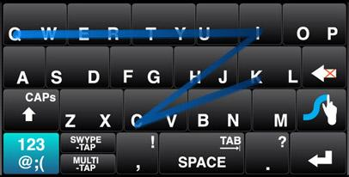
One Idea: Continuous Motion
"QUICK"
http://www.swype.com/

Slide 9
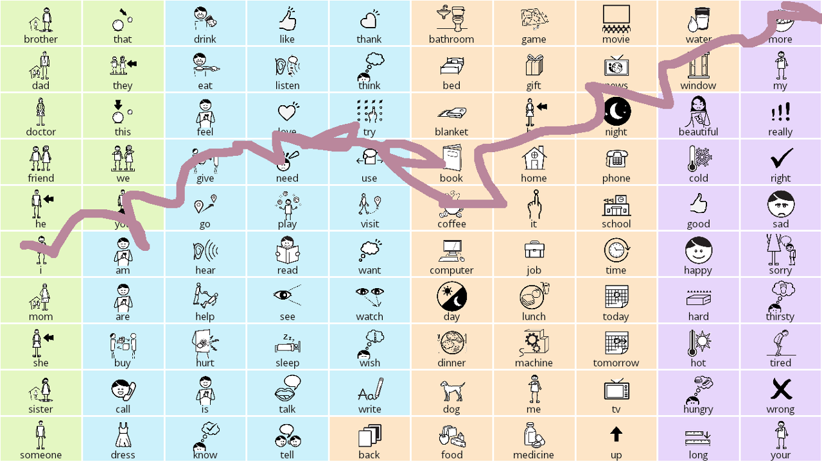
SymbolPath: A Prototype
"I need more coffee."
Wiegand, K., & Patel, R. (2012). SymbolPath: a continuous motion overlay module for icon-based assistive communication. ASSETS '12, (pp. 209-210). New York, NY, USA: ACM.

Slide 10
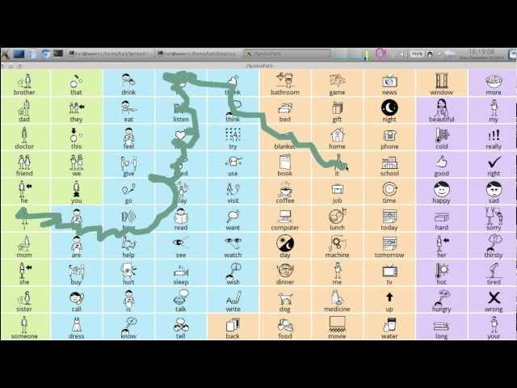
SymbolPath in Action

Slide 11
How It Works: Language Model
Semantic frames
  Verbs have "frames" that take certain "roles"
  Each word can fill certain "roles"
Give ( Agent, Object, Beneficiary )
Free-order word statistics (co-occurrence)
Display the final sentence choices (for now)
Fillmore, C. J. (1976). Frame semantics and the nature of language. Annals of the New York Academy of Sciences, 280 (Origins and Evolution of Language and Speech), 20-32.
Wiegand, K., & Patel, R. (2012). Non-Syntactic word prediction for AAC. In Proceedings of the Third Workshop on Speech and Language Processing for Assistive Technologies, (pp. 28-36). Montréal, Canada: Association for Computational Linguistics.

Slide 12
Initial User Questions
Who are the intended users?
  Current users of icon-based AAC
  Especially users with upper-limb motor impairments
  Meant for integration with other systems
Which boards does it have?
When can we try it out?

Slide 13
What We've Learned So Far
Two adults with speech and motor impairments: "It's fun!"
Suggested sentences can be amusing
(i.e. "wrong")
It doesn't actually require touch input:
  Broad/flat stylus, joysticks, paddles, etc.
It doesn't work well for people with spasms

Slide 14
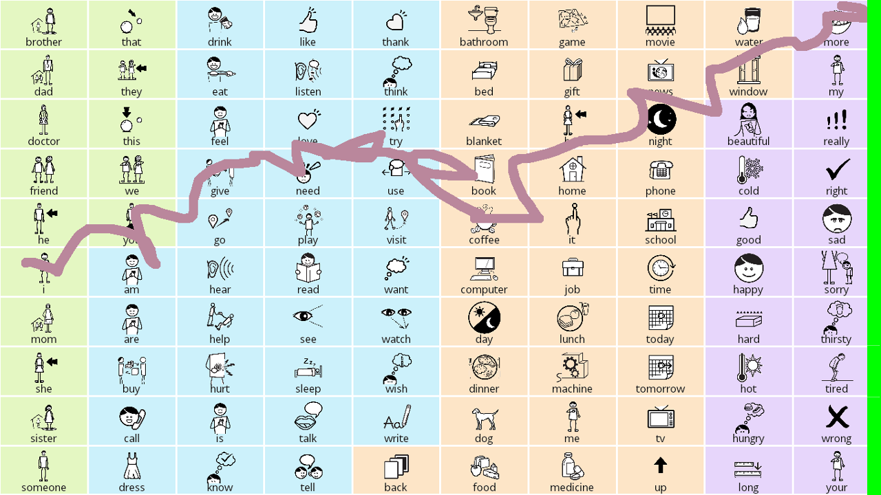
Future Addition: "Finish Line"

Slide 15
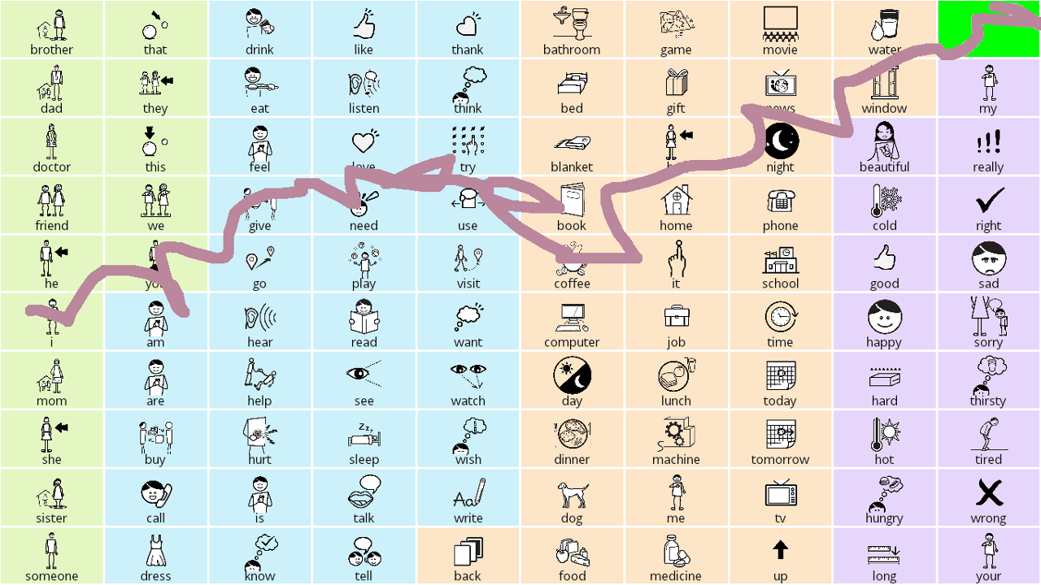
Future Addition: "Finish Area"

Slide 16

Other Planned Additions
Support for multiple and individualized boards
Prediction problem:
  Statistics from real AAC users provide better prediction
  Help, please?

Slide 17
Let's Dream Together a Little Bit...
From the mother of a young AAC user:
I want my daughter to be able to say everything. Every single thing that pops into her head -- from "I want water" to "That rhinoceros is purple" to "Yellow pineapple makes my lips itch."

Slide 18
My Response
"YES!"

Slide 19
...But How?
One obvious solution: use letters
What if we can't or don't want to?
Problems we need to solve:
  How to display the vocabulary?
  How to navigate the vocabulary?
  How to do all of this stuff quickly?

Slide 20
Back to the Drawing Board
What if we actually knew what just popped into the user's head?
Brain-Computer Interfaces (BCI) or Brain-Machine Interfaces (BMI)
Often designed assuming a minimal number of input signals
Primarily used for people with Locked-In Syndrome (LIS)

Slide 21

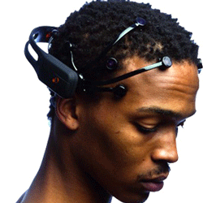
...But Also for Novelty
http://www.emotiv.com/
http://www.neurosky.com/

Slide 22
On Brain-Computer Interfaces
Different signals:
  Electroencephalography (EEG)
  Functional Magnetic Resonance Imaging (fMRI)
  and many others...
Different techniques and approaches:
  Motor imagery
  Steady state visual evoked potentials (SSVEP)
  P300 and Event Related Potentials (ERP)
  and many others...

Slide 23
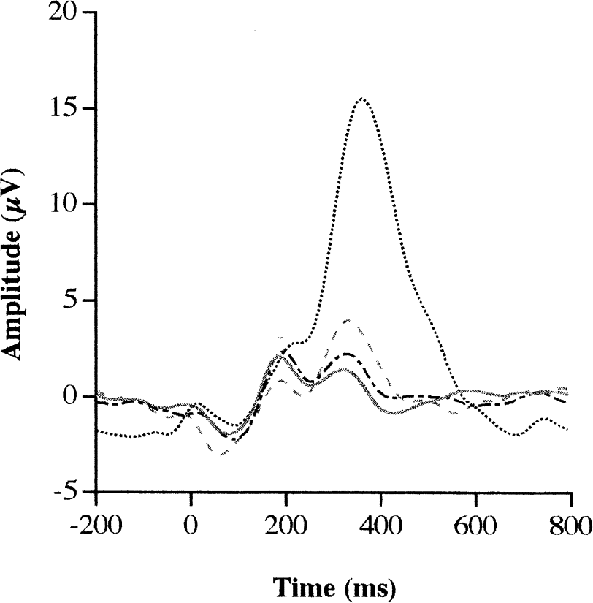
The P300 Wave

Slide 24
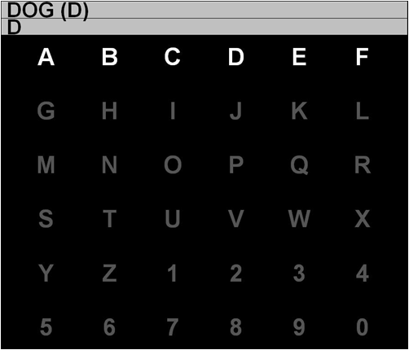
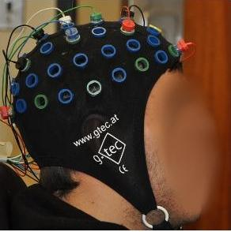
A Letter-Based Example
P300 Speller (or Matrix Speller)
http://www.etsu.edu/cas/bcilab/
Notes:
The P300 is often elicited through event-related potentials (ERP) signals, such as through RSVP, which stands for...

Slide 25

Related Project: RSVP-Keyboard
Orhan, U., II, K. E. H., Erdogmus, D., Roark, B., Oken, B. & Fried-Oken, M. (2012). RSVP keyboard: An EEG based typing interface.. In ICASSP (pp. 645-648) . IEEE . ISBN: 978-1-4673-0046-9
Notes:
Another type of RSVP is what some people call "keyhole RSVP," such as used by this project, RSVP-Keyboard. RSVP-Keyboard is a joint project between Professor Deniz Erdogmus at Northeastern and the Center for Spoken Language Understanding at Oregon Health and Science University...

Slide 26
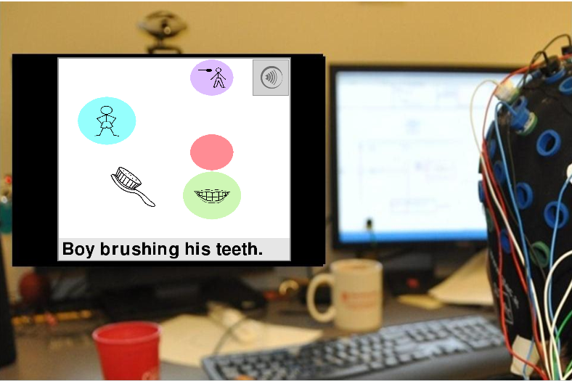
RSVP-iconCHAT
Wiegand, K., Patel, R., & Erdogmus, D. (2010). Leveraging Semantic Frames and Serial Icon Presentation for Message Construction. ISAAC Conference for Augmentative and Alternative Communication, Barcelona, Spain, July 2010.

Slide 27
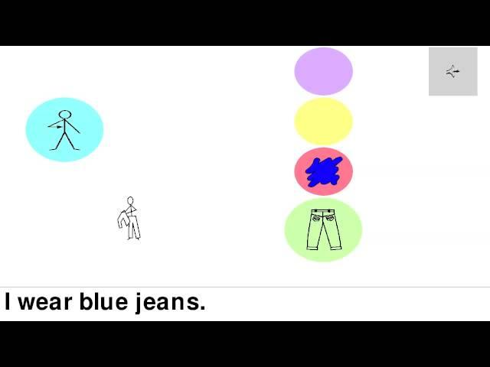
RSVP-iconCHAT in Action

Slide 28
Initial User Questions
Who are the intended users?
  Primarily people with locked-in syndrome (LIS)
  Users of BCI-controlled wheelchairs
Do I have to concentrate?
  Not exactly, but some users are "better" than others
What does it feel like?

Slide 29
What We've Learned So Far
Experiments with non-AAC users and letter-based RSVP (RSVP-Keyboard)
Non-AAC users get frustrated (surprise!)
Staying attentive can be tiring
Prediction is extremely important for speed and comfort
It doesn't work well for people with spasms

Slide 30
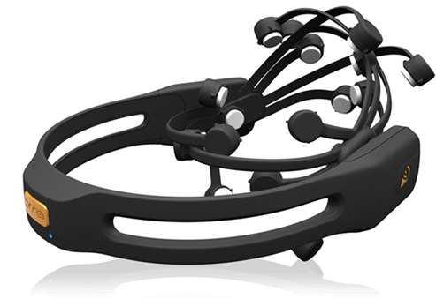
Future Directions
Improve the signal detection and word prediction
Begin testing with current AAC users
Translate the system and approaches into a portable package
http://www.emotiv.com/

Slide 31
Why We Need Help
Prediction is extremely important
Prediction is primarily based on data
More realistic data is better
There isn't a lot of real AAC data out there
We need to train our algorithms on realistic AAC data

Slide 32
How You Can Help
Getting ideal data creates privacy concerns
Asking current AAC users is a good start
We'd like to ask the families, friends, and teachers of real AAC users
What do you talk about? How? When? What would you like to talk about?
Boards, logs, or word lists would be great!

Slide 33
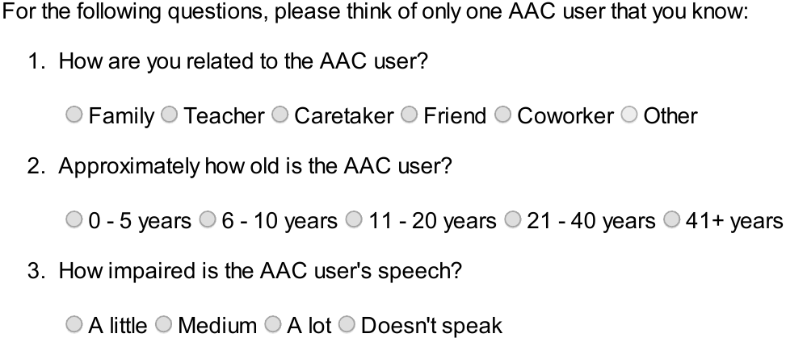
CadLab Corpus Project
karlwiegand.com/csun2013/

Slide 34
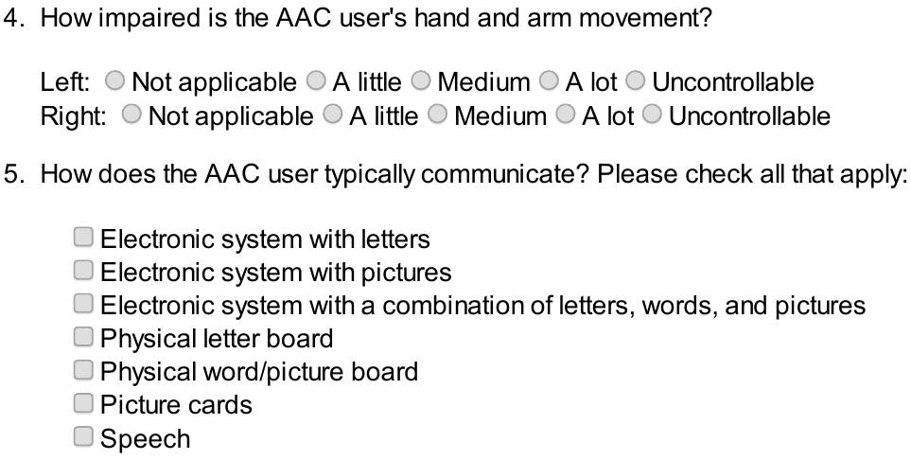
Survey Demographics
karlwiegand.com/csun2013/

Slide 35
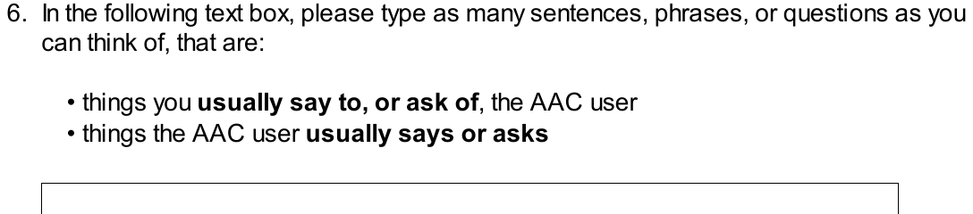
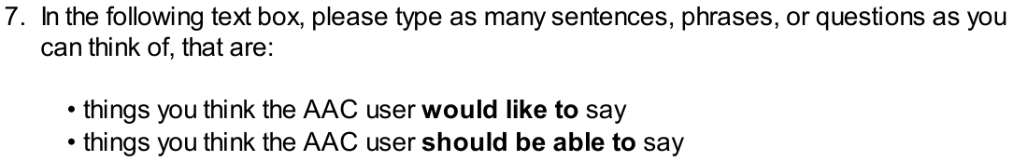
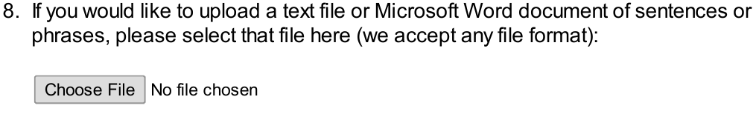
The Core of the Survey
karlwiegand.com/csun2013/

Slide 36


Thank you for listening!
karlwiegand.com/csun2013
Grant #0914808

