Slide 1

Approximation Models of
Combat in StarCraft 2
Ian Helmke
Dan Kreymer
Karl Wiegand
CS 7180 - Sliva
October 21, 2012

Slide 2
Outline
Background and Motivation
Problem Statement
Approach and Method
Results
Applications and Limitations
Future Work

Slide 3
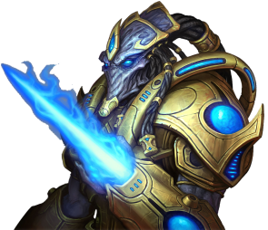
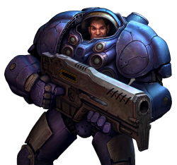
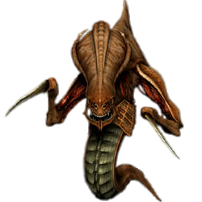
Background: StarCraft 2
Real-Time Strategy (RTS) computer game
Gameplay: Gather, build, research, attack, and then destroy all enemy buildings
Complex, zero-sum, partial information game
Popular game series for testing AI systems

Slide 4






Problem Statement: One Battle
Given the composition of two armies, which army will win and which units will remain?
Terran | Zerg
12 Marines 4 Marauders 4 Hellions | 24 Zerglings 4 Roaches 4 Hydralisks
50% | 50%
2 Marines 2 Marauders 1 Hellions | 3 Hydralisks

Slide 5
Approach: Approximations
Units have health, DPS, flags, and basic attributes based on unique type
APX1: Randomized perfect focus fire
APX2: Free round of attacks by ranged units
APX3: Attributes and bonus damage
APX4: Preferred targeting of melee units

Slide 6
Method: In-Game Testing
12 matches: 4 rounds of 3 different combinations (PvT, TvZ, PvZ)
Each round increased complexity and size
12 custom maps with 10 battles per match
Tracked compositions and win percentages
APXn: 12 simulations based on 1,000 rounds

Slide 7
Example: Replay of Test Battle

Slide 8
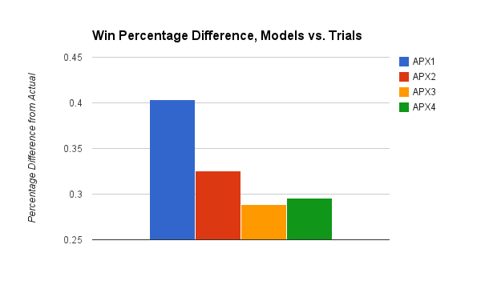
Results: Predicting Victory

Slide 9
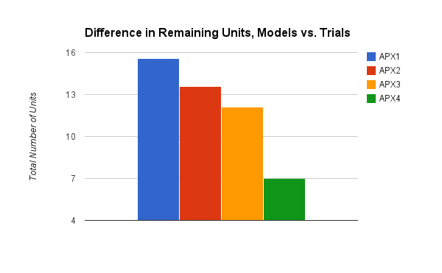
Results: Predicting Remaining Units

Slide 10
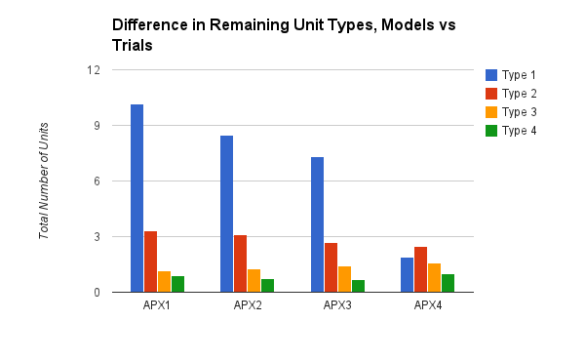
Results: Predicting Remaining Units

Slide 11
Applications and Limitations
Good:
Victory determination in decision trees
Heuristic for many planning algorithms
Selectively use/combine this model
Bad:
No micromanagement or formations
Okay:
No technology or spells

Slide 12
Future Work
Technology as a set of rules and effects
Spellcasters assumed to be fully effective
More testing or creation of a test corpus
POMDP for victory prediction
Combine with player-specific models to account for micromanagement

Slide 13
?
Full report, code, maps, replays, and all results are available at: [https://bitbucket.org/karlwiegand/sc2apx].

