Slide 1
Pre-Presentation Notes
Slides and presentation materials are available online at:
karlwiegand.com/chi2014

Slide 2
What is the Goal?
Make AAC more intelligent and personalized
"Intelligent" meaning:
User-specific
Adaptive
Context-sensitive

Slide 3
Why?
Current AAC is a relatively passive channel
Mostly just "customizable"

Slide 4
How?
By addressing some common assumptions:
Prescribed Order
Intended Set
Discrete Entry

Slide 5
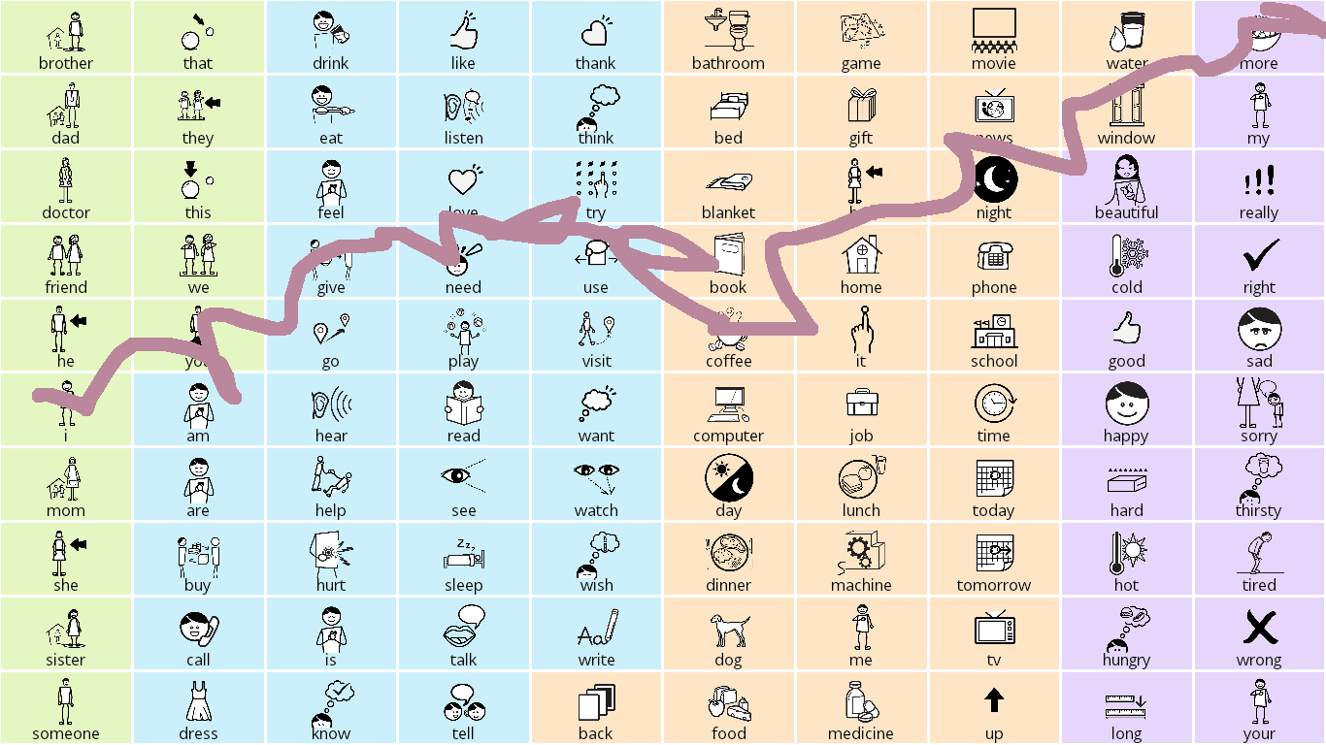
One Example: SymbolPath
"I need more coffee."

Slide 6
Workshop Ideas
Are there other problematic assumptions?
Would a common AAC framework help?
Thank you for listening!
karlwiegand.com/chi2014

