Slide 1
Semantic Disambiguation of
Non-Syntactic and
Continuous Motion Text Entry
for Icon-Based AAC
Karl Wiegand
Northeastern University
Boston, MA USA
October 21, 2012

Slide 2
Outline
Background on AAC
Problem Statement and Thesis
Projects and Goals
Theories and Approaches
Implementation and Experiments

Slide 3
Outline
Background on AAC
Problem Statement and Thesis
Projects and Goals
Theories and Approaches
Implementation and Experiments

Slide 4
What is AAC?
Augmentative and Alternative Communication
Three major categories:
Assisted communication
Physical boards with letters, words, or images
Electronic devices with integrated Text-to-Speech (TTS) systems
Notes:
...intended for anyone for whom spoken communication is extremely difficult or infeasible.

Slide 5
Who uses AAC?
People of all ages
People with:
cerebral palsy (CP)
amyotrophic lateral sclerosis (ALS)
brain and spinal cord injuries
neurological disorders (e.g. aphasia)
muscular dystrophy
paralysis, autism, and more...
Notes:
Used by people with a wide variety of conditions, such as CP or ALS, or neurological disorders, such as aphasia from stroke.

Slide 6
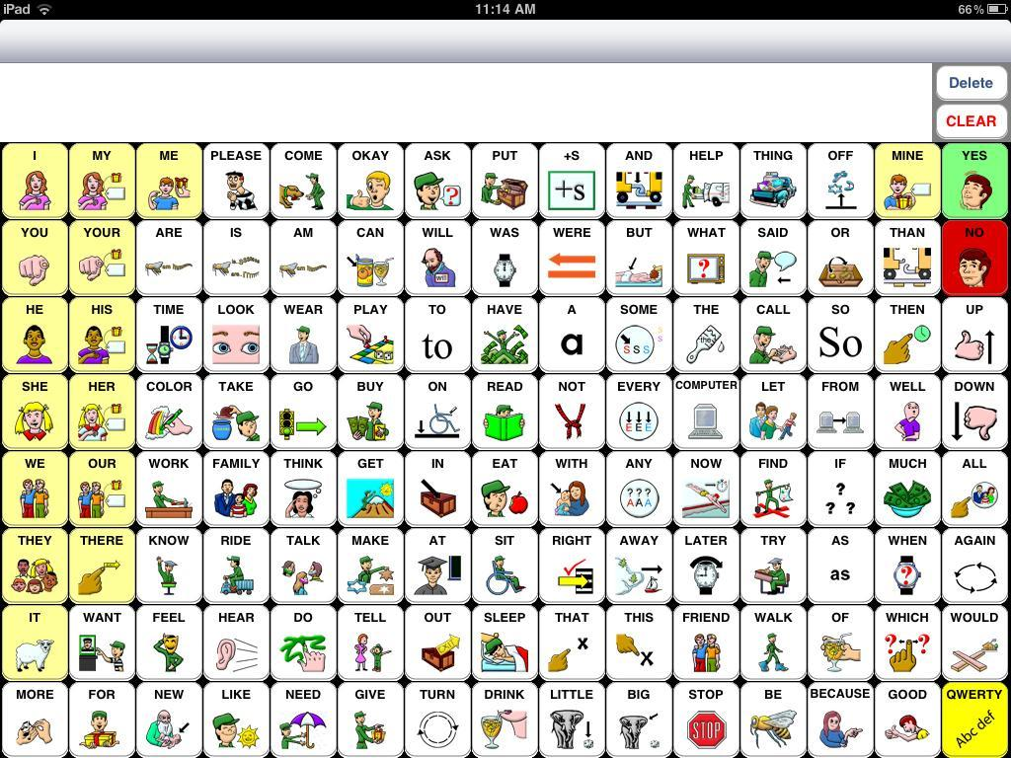
Current AAC System
Notes:
SpeakForYourself, an icon-based AAC application for iOS and Android

Slide 7
Scope and Definitions
Target users are primarily non-speaking and may have upper limb motor impairments
Target users may also have language impairments (e.g. aphasia)
"Icon-based AAC" includes systems that use words, icons, or a combination of both
"Non-syntactic" is non-standard syntax or inconsistent syntax

Slide 8
Outline
Background on AAC
Problem Statement and Thesis
Projects and Goals
Theories and Approaches
Implementation and Experiments

Slide 9
Problem Statement
Current icon-based AAC systems assume:
Syntactic Order
Intended Set
Discrete Entry

Slide 10
Assumption 1: Syntactic Order
Users will select icons in the syntactically correct order of the target language.
Without syntactic order, how do we handle directional utterances? (near vs. like)
Users do not always select icons in syntactic order (Van Balkom and Donker-Gimbrere, 1996)
Using AAC devices is slow (Todman, 2000; Wolpaw et al, 2002; Muller and Blankertz, 2006)

Slide 11
Assumption 2: Intended Set
Users will select exactly the icons that are desired -- no fewer or more.
Without this, how do we complete subsets (predict) or prune supersets (correct)?
Motor impairments and tremors may result in missing or additional selections (Ball, 2005)
Letter-based text entry systems detect accidental and deleted selections

Slide 12
Assumption 3: Discrete Entry
Users will make discrete movements or selections, either physically or with a cursor.
Selection is important; path is irrelevant
Recent letter-based systems have started to remove this assumption (Goldberg, 1997; Kushler and Marsden, 2008; Rashid and Smith, 2008)
Removing this assumption enables the use of continuous input signals

Slide 13
Thesis Statement
These three assumptions are problematic and burdensome to users.
Algorithms and design approaches can mitigate the need for these design constraints.
Alleviating these constraints can:
Result in faster, less fatiguing communication
Enable the use of new input modalities

Slide 14
Outline
Background on AAC
Problem Statement and Thesis
Projects and Goals
Theories and Approaches
Implementation and Experiments

Slide 15
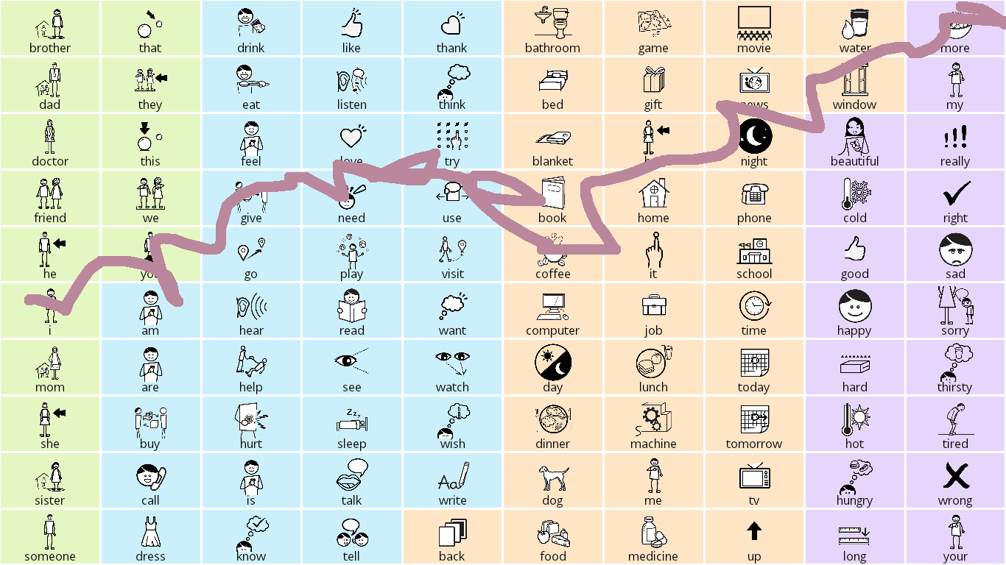
Project: SymbolPath
Relaxation of all three major assumptions
"I need more coffee."

Slide 16
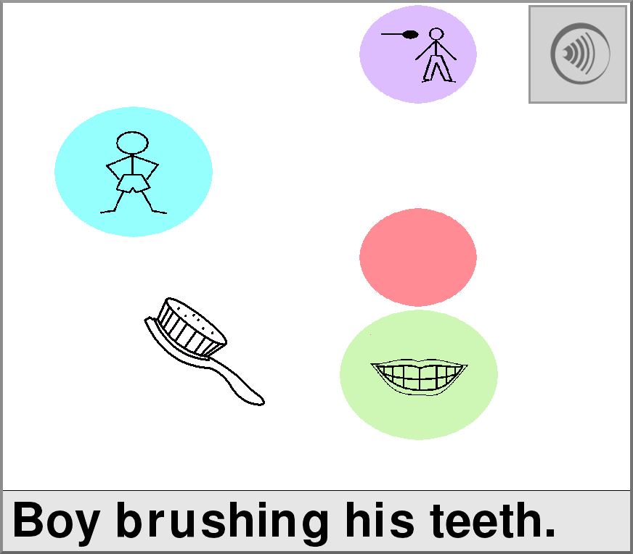
Project: RSVP-iconCHAT
Continuous input signal (BCI) and non-syntactic message construction
Notes:
An icon-based AAC system controlled by a brain-computer interface.

Slide 17
Goals
For current AAC:
Completion and correction
Continuous motion
For future AAC:
Faster communication
New input modalities
Vowel sounds
Electromyographic responses (EMG)
Brain-computer interfaces (BCI)

Slide 18
Outline
Background on AAC
Problem Statement and Thesis
Projects and Goals
Theories and Approaches
Implementation and Experiments

Slide 19
Addressing Syntactic Order
Semantic frames (Fillmore, 1976)
Verbs have a "frame" with semantic roles:
Give ( Agent, Object, Beneficiary )
WordNet, FrameNet, "Read the Web"
Verb-first message construction (Patel et al, 2004)
Any order in RSVP-iconCHAT
Notes:
Emphasize that last bullet is CURRENT WORK; all else is prior work.

Slide 20
Addressing Intended Set
Subset completion and superset pruning
N-grams; Compansion (McCoy et al, 1998)
Semantic grams (Wiegand and Patel, 2012)
"I like to play chess with my brother."
brother, chess | brother, i | brother, like
brother, play | chess, i | ...
brother, chess, i | brother, chess, like
brother, chess, play | chess, i, like
chess, i, play | ...
Notes:
Semantic grams is CURRENT WORK.

Slide 21
Addressing Discrete Entry
Physical path or signal characteristics
Letter-based continuous motion (Goldberg, 1997; Kushler, 2008)
Relative positioning vs. exact locations (Rashid, 2008)
Merge semantic salience with path attributes
SymbolPath considers:
Starting and ending locations
Movement speed
Pauses, stops, or sudden changes in direction
Jitter and tremor
Notes:
SymbolPath is CURRENT WORK uses a linear mixture model that incorporates information about...

Slide 22
Outline
Background on AAC
Problem Statement and Thesis
Projects and Goals
Theories and Approaches
Implementation and Experiments

Slide 23
Proposed Corpus Experiments
Semantic roles:
Sem-grams vs. WordNet & FrameNet vs. tuples (left words, verb, right words)
Contextual cues:
Location, time of day, discourse markers
Syntactic reordering:
FrameNet vs. N-gram-based permutations
Notes:
This is all FUTURE WORK that I plan to do as part of my dissertation. Three potential corpora: Crowdsourced AAC-like corpus, Enron emails, and transcripts from The Boston Home.

Slide 24
Proposed User Experiments
RSVP-iconCHAT:
Create a sentence
Describe a picture scene
Clinical trial with regular feedback
SymbolPath:
Type vs. draw
Respond to a prompt
App Store release and feedback
Notes:
This is all FUTURE WORK.

Slide 25
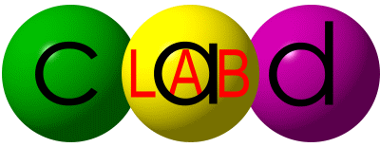
Thank you for listening!
Special thanks to my advisor, Dr. Rupal Patel, and the National Science Foundation (Grant #0914808).

